Slide 1

District One Traffic Safety Academy
Presented by: Larry Hagen, P.E., PTOE, RSP
Session 1 - Introduction

Slide 2

Introduction:
What is the Academy
  What to expect
  How it works

Slide 3
Strategic Highway Safety Plan

Slide 4
Resources – Strategic Highway Safety Plan (SHSP)
Required of each state by FHWA in order to receive federal safety funds
The SHSP is a statewide, data-driven safety plan for all of Florida’s road users
Identifies 13 “Emphasis Areas”
Emphasis Areas guide the safety efforts
Focus is on fatalities and serious injury crashes

Slide 5
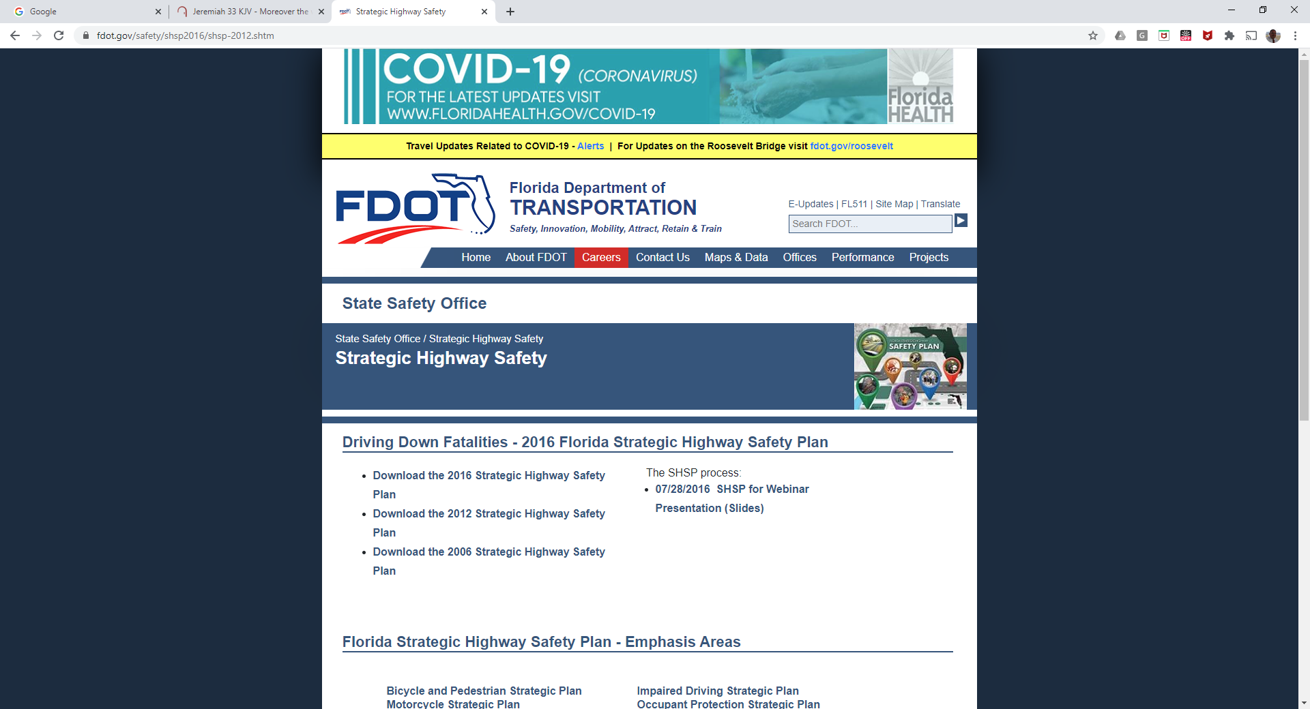

Slide 6
Notes:
Current version is the 2016 version. It is typically updated every 5 years. The 2021 version is currently being worked on.

Slide 7
Notes:
Truly multi-disciplinary. Look at the people that signed off on it here:

Slide 8
Vision is a Fatality Free Transportation System
So how are we doing in pursuit of that goal?
Notes:
Numbers are heading the wrong way.

Slide 11
Elderly Road Users in Florida
According to the Department of Highway Safety and Motor Vehicles:
There are 1,256,839 licenses for people 65-69 years old
There are 1,862,415 licenses for people 70-79 years old
There are 713,085 licenses for people 80-89 years old
There are 112,148 licenses for people 90+ years old
Notes:
Statistics as of January 1, 2020

Slide 13
Florida’s Transportation System
Note how sparse the bicycle / pedestrian network is on the State Highway System

Slide 14
State vs Local Roads

Slide 15
Florida’s Urban Areas
Notes:
Remember: 9 out of 10 Floridians live in urbanized areas

Slide 16
Notes:
13th Emphasis Area – Improve Crash Data (Traffic Records and Information Systems)

Slide 20
Notes:
We now look at specific strategies related to each of the emphasis areas.

Slide 37

Questions?

Slide 38
Crash Data Resources

Slide 39
Fatality Analysis Reporting System
Maintained by NHTSA
National records of fatal crash data
Typically about two years behind
Good historical and trend data

Slide 40
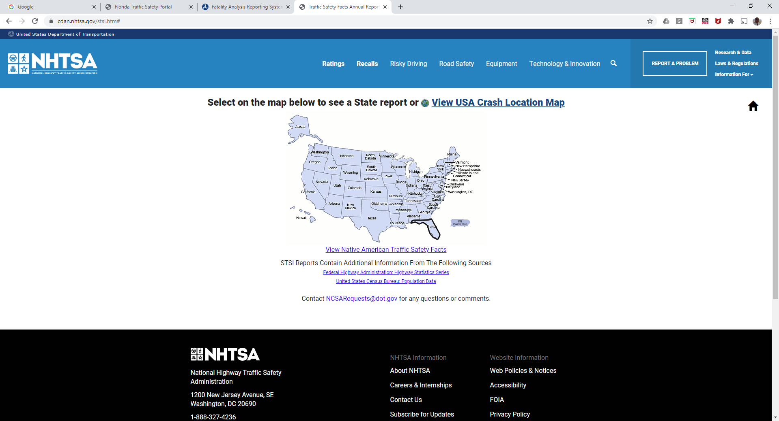
Notes:
From the FARS website, you can select Florida data.

Slide 41
Crash Analysis Reporting System
Maintained by DHSMV
Statewide database of vehicle crash data
Typically one to two years behind
Summaries only – no crash narratives
Certified crash data that goes to NHTSA

Slide 42
Signal 4 Analytics
GIS-based crash record management system
Maintained by the University of Florida
Pretty current crash data
Input from state and local sources
Includes link to .PDF of crash report
Charts & graphs to simplify analysis
Export to Excel for further analysis
Notes:
Can also do rough high-level analysis similar to CARS. But NOT the certified numbers.

Slide 43
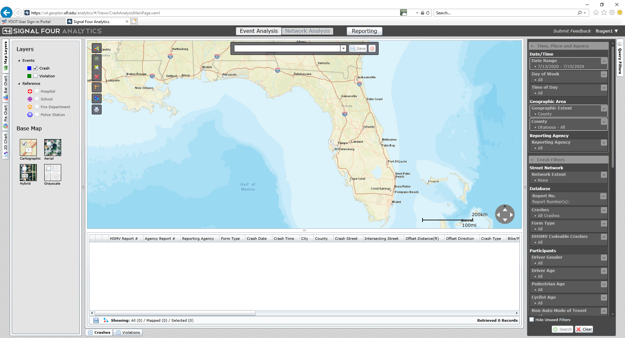

Slide 44
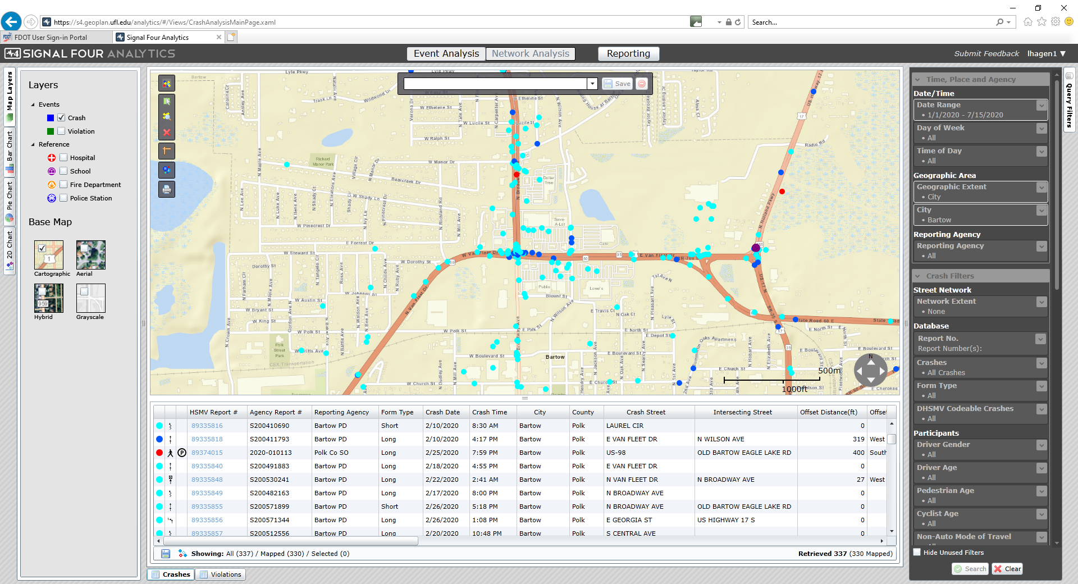

Slide 45
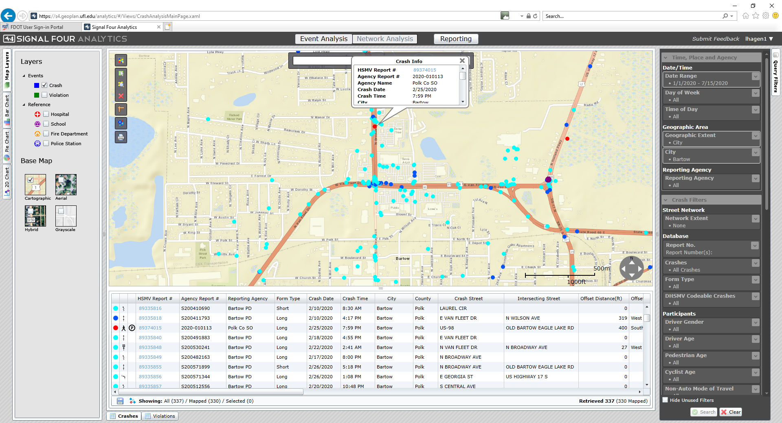
Notes:
You can click on any of the dots here to see more information about that particular crash, including the crash number, with a hot-link to the crash report.

Slide 46
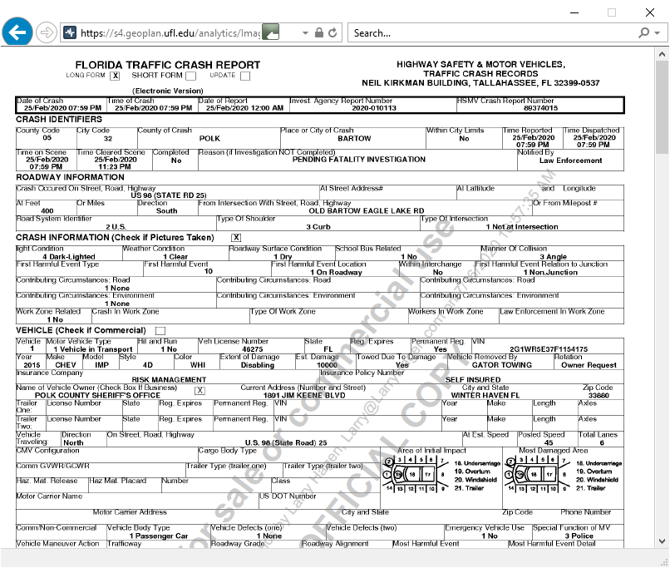

Slide 47
Crash Countermeasure Resources

Slide 48
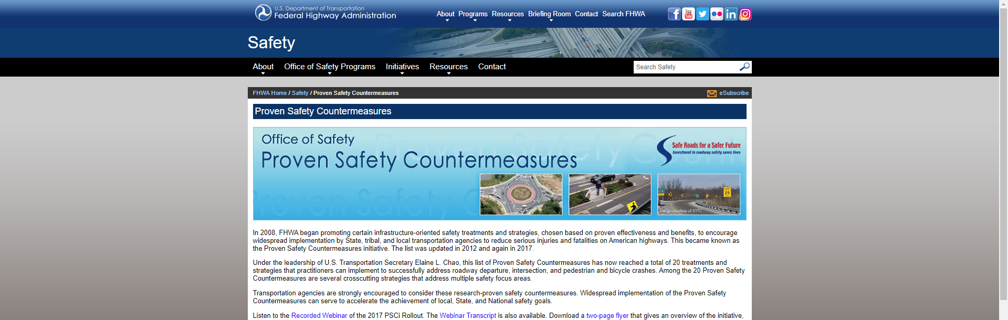
FHWA’s Proven Safety Countermeasures
www.safety.fhwa.dot.gov/provencountermeasures

Slide 49
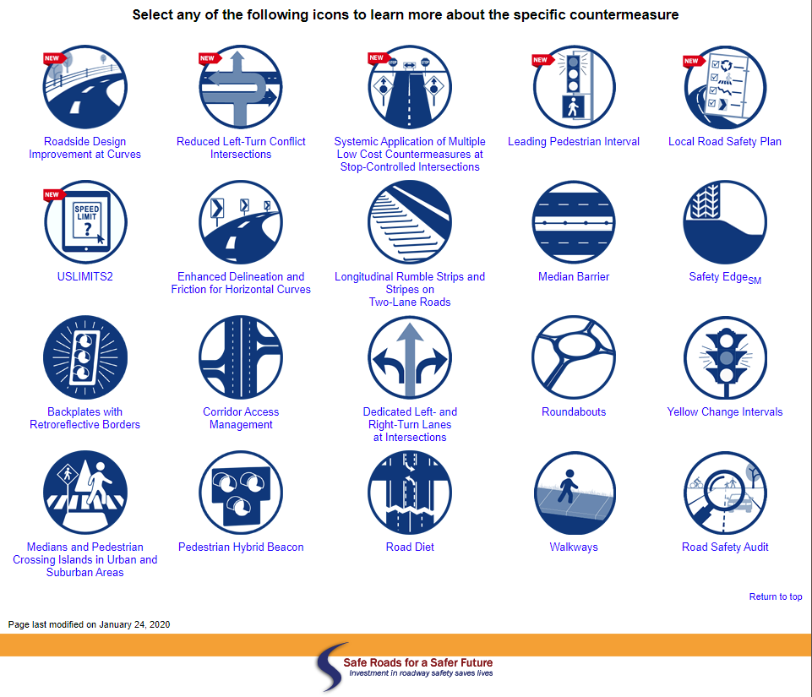
Notes:
20 proven countermeasures. On the FHWA website, you can click on any of these icons to find out more about these specific countermeasures.

Slide 50
FHWA Intersection Safety Strategies
Notes:
FHWA Intersection Safety Strategies Brochure

Slide 51
FHWA Intersection Safety Strategies
Notes:
FHWA Intersection Safety Strategies Brochure

Slide 52
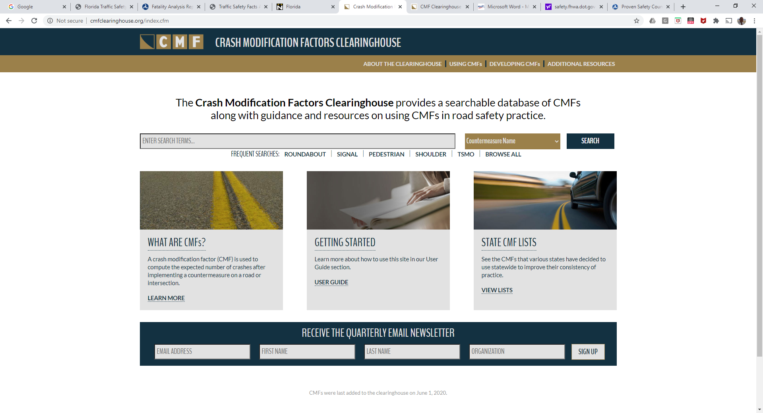
Crash Modification Factors Clearinghouse
www.cmfclearinghouse.org

Slide 54
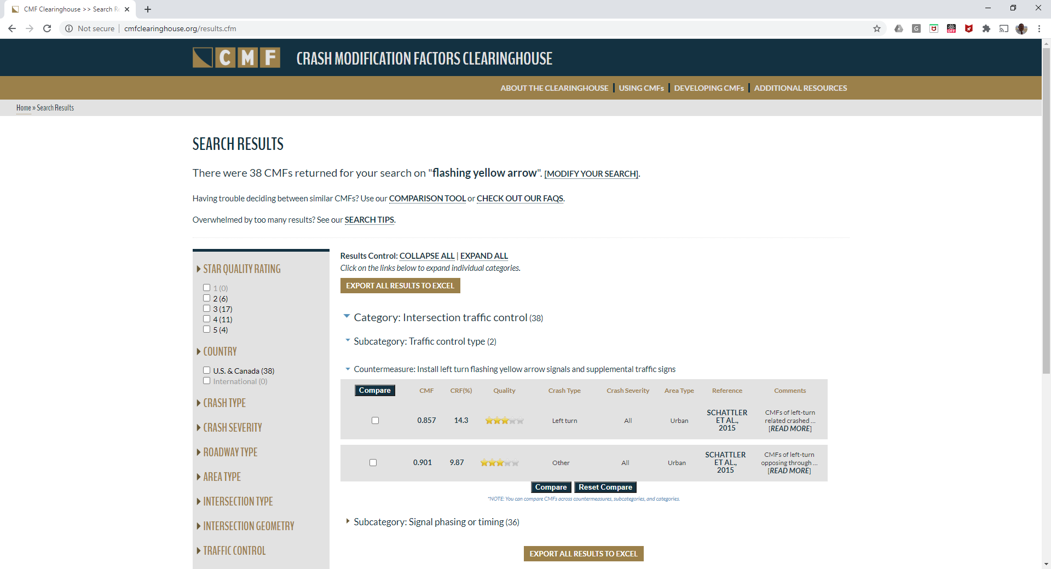
Notes:
I searched for “flashing yellow arrow.” It returned 38 CMFs: 2 under Traffic Control Type, 36 under Signal Phasing or Timing.

Slide 55
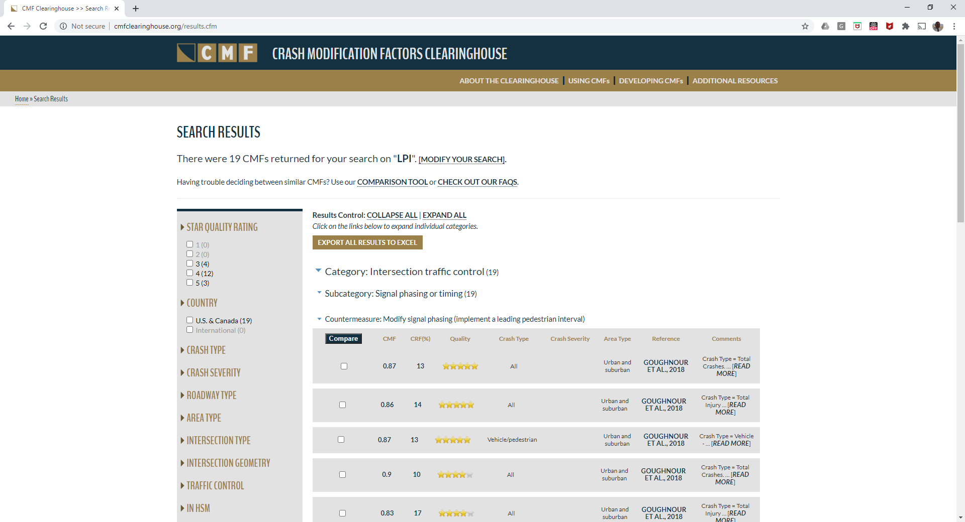
Notes:
Here, I searched for LPI = Leading Pedestrian Interval. 19 CMFs were found for LPI. Look at the first five of the 19 here.

Slide 56
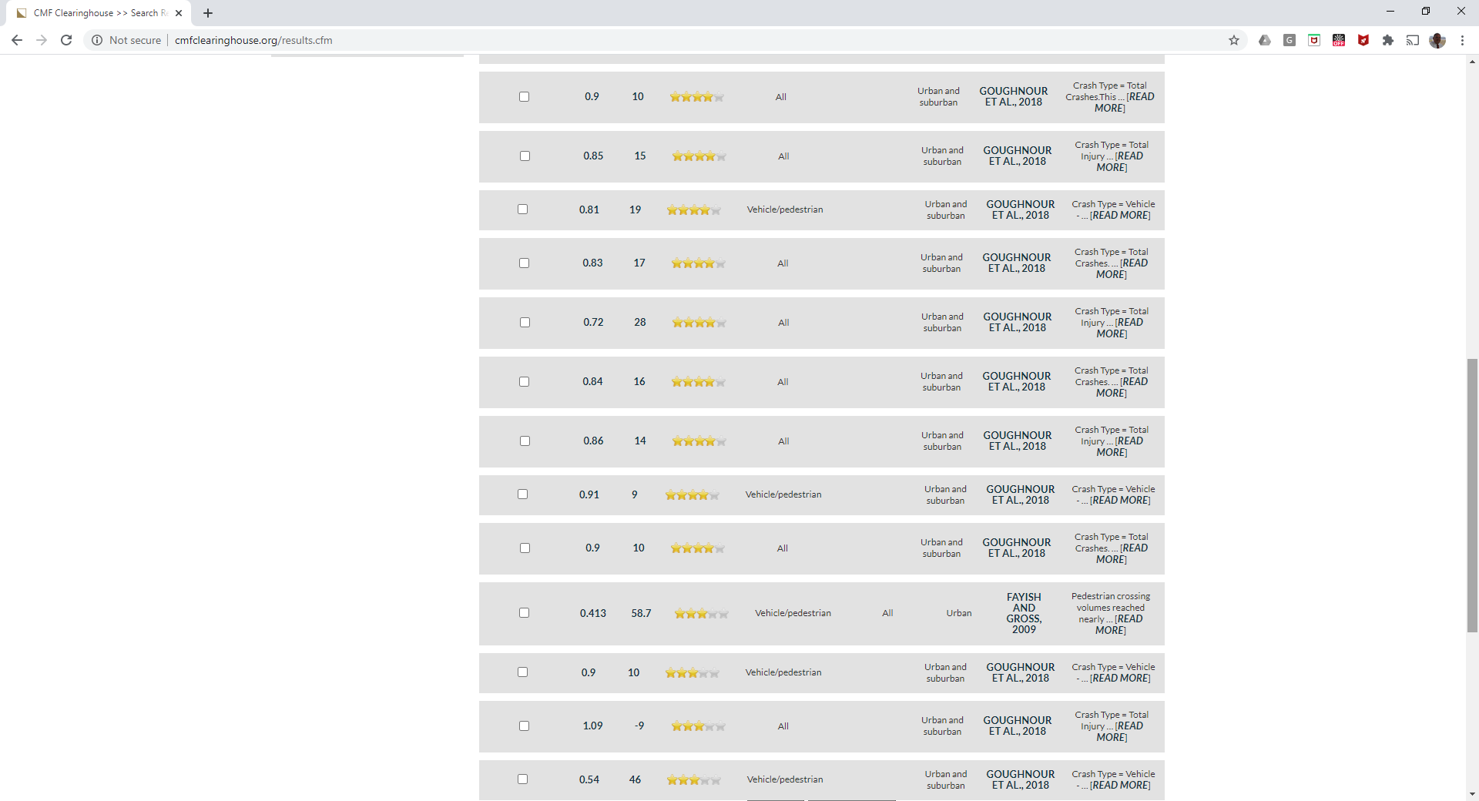
Notes:
Here are more of the CMFs for putting in a LPI. The values range from 0.72 to 1.09 for all crashes, and 0.413 to 0.91 for vehicle/ped crashes. That means between 28% crash reduction and 9% crash increase for all crashes; and a 9% to 58.7% reduction in veh/ped crashes. That is a pretty wide range! Which one do you use? That is a topic we will look at in a later session.

Slide 57
Notes:
FHWA’s Desktop Reference for Crash Reduction Factors

Slide 60
Notes:
Note all the different CRFs for improving the change intervals. Note for older drivers; 42% CRF! Need to note that ITE recently update the recommended practice.

Slide 61
Notes:
Note 70% reduction in emergency vehicle crashes by using preemption. Look at all of the ped signal CMFs!

Slide 62
Notes:
Note that LPI only has 5% CRF here. Actuation of a signal has 80% CRF for left turn crashes?

Slide 63
Questions?

Slide 64
Why are we doing this?

Slide 65

We all have families / loved ones that use the roads
Notes:
Sometimes in our vehicles…

Slide 66
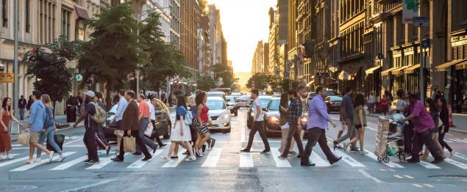
We all have families / loved ones that use the roads
Notes:
Sometimes as pedestrians.

Slide 67

We all have families / loved ones that use the roads
Notes:
Sometimes as pedestrians.

Slide 68
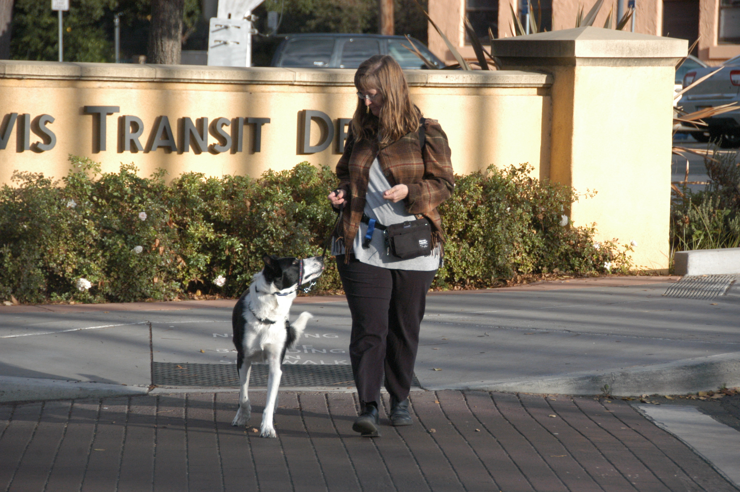
We all have families / loved ones that use the roads
Notes:
Sometimes as pedestrians.

Slide 69
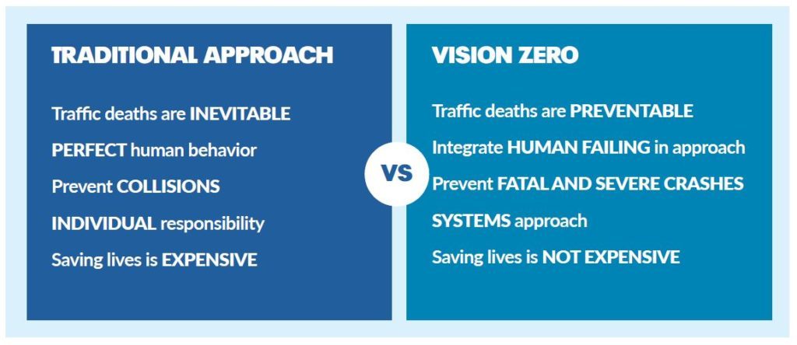
Vision Zero – A New Vision for Safety
Notes:
We will talk in another session about the Safe Systems approach and what it means and where it could take us.

Slide 70
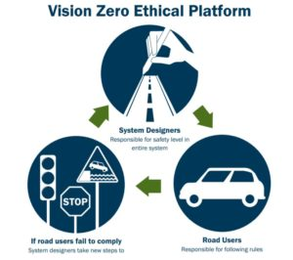
Taking the Lead for Safe Streets
Vision Zero is not a slogan, not a tagline, not even just a program. It is a fundamentally different way to approach traffic safety.

Slide 71
Questions?
Notes:
Go to www.trafficsafetyguru.com/safetyacademy

Slide 72
Thank you for attending today’s session!
Notes:
In our next session, we will be talking about safety treatments. It will be on Monday, the 19th at 10AM.

