Slide 1
Basic Traffic Safety Academy –
Module 1
April 26 2022

Slide 2
What is the Academy?
The Academy is designed as an interactive experience to give anyone the ability to successfully determine and solve safety issues on our roadways.

Slide 3
What is the Academy?
Understand Our Mission
Understand How to Find and Use Data
Understand Our Top 3 Problems
Learn to Solve the Top 3 Problems
Demonstrate Mastery by Fixing an Actual Project
Notes:
Key Message: This slide breaks down the big ideas of the Academy.
This is a big picture look at how this Academy is structured.
We will start off discussing exactly what it is we are facing.
Then we will discuss one of the most critical parts of designing for safety: the data. We need to understand how data works, where to find it, and how to use it correctly.
Next, we will take a dive into Florida’s Top 3 Problems.
We will learn to solve them,
And finally, we will work to apply these lessons to a real project.

Slide 4
What is the Academy?
Introduction
Spot Treatments
vs Systemic vs
Best Practices vs
Standards
How to Perform a Crash Evaluation
Determination of Countermeasures
Speed Calming and Speed Management
Lane Departure
Pedestrian & Bicycle Safety
(2 Parts)
Intersection Safety
(2 Parts)
Road
Safety
Audits
Safety Evaluation Workshop
Notes:
This slide breaks down the different modules of the Academy.
Key Message: Describe the different modules and how they flow into each other. Identify that this session is the first module “Introduction”

Slide 5
What Will We Cover Today?
What is the problem we are facing?
What is Target Zero?
What is the Safe Systems Approach?
What is FDOT doing?
Notes:
Key Message: This is the basic introduction slide. These are the learning objectives of this module. Participants should be able to articulate the answer to each of these questions at the end.
Take time here to ask people what they hope to understand and learn. This can be used to help guide the conversation in future slides.

Slide 6
Why are we here today?
One life lost is too many
Fatalities
Serious Injuries
On Florida’s Roads Each Day
Notes:
Key Message: Hit on the impact of these numbers. Compare to number of people in the training room. Really hit on how many people this is, and how families are affected when this happens.
Consider asking class how many deaths they feel would have been in the US in 2019? (Prep for next slide – 36,000)

Slide 7
Our Current Reality
Traffic fatalities are a public health crisis affecting all road users.
1.25M
36,096
6,205
Lives lost globally each year from traffic crashes
Source: World Resources Institute
Lives lost on US roads in 2019
Source: NHTSA
Pedestrians killed in US traffic crashes in 2019
Source: NHTSA
Notes:
Key Message: Build up to the national level. Show that this is a national epidemic.

Slide 8
How Are We Doing?
Notes:
Key Message: This shows that we were reducing fatalities and SI pretty well all the way to 2019.
- Mention “Alert Today, Alive tomorrow” campaign
Mention Safety Coalitions: Motorcycle, Aging road users, bike/ped, etc.
Mention introducing roundabouts
Faster response times and less secondary accidents on limited access roadways due to larger/better ITS networks
Note that fatalities have stayed even

Slide 9
However…
Notes:
Key Message: transition slide

Slide 10
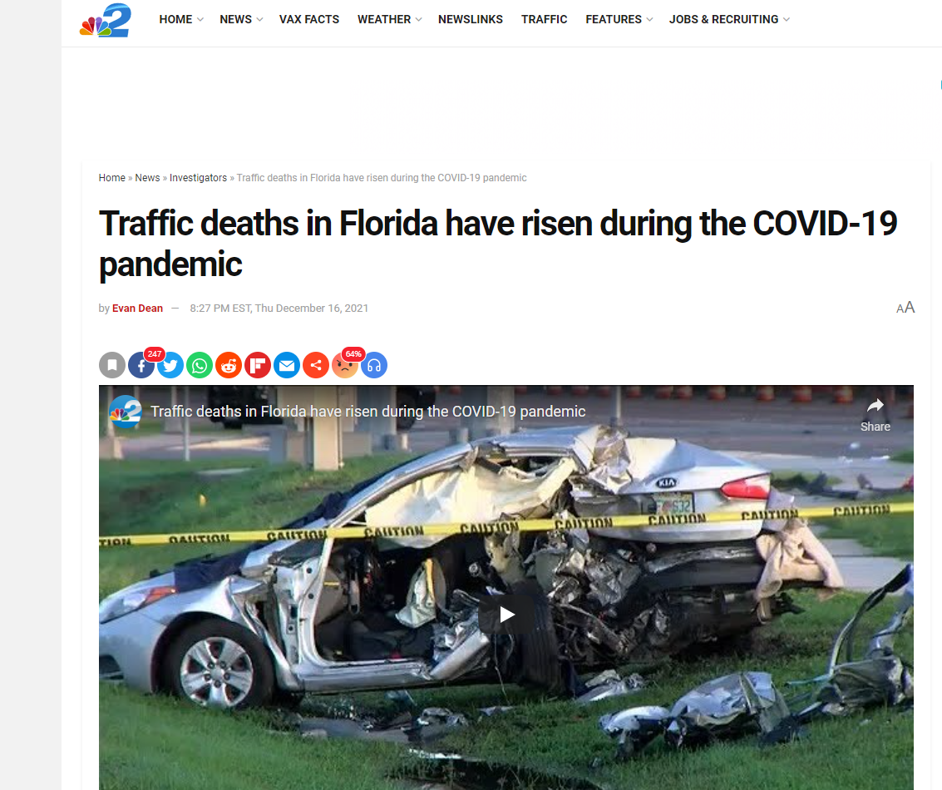
Notes:
Key Message: We have seen spike in Fatal/SI during the COVID 19 era.
If speeding is an answer, lean into it to support future modules.
If not, mention that there is evidence that increased speeding due to less traffic is believed to be an issue.
Ask participants why that might be?

Slide 11
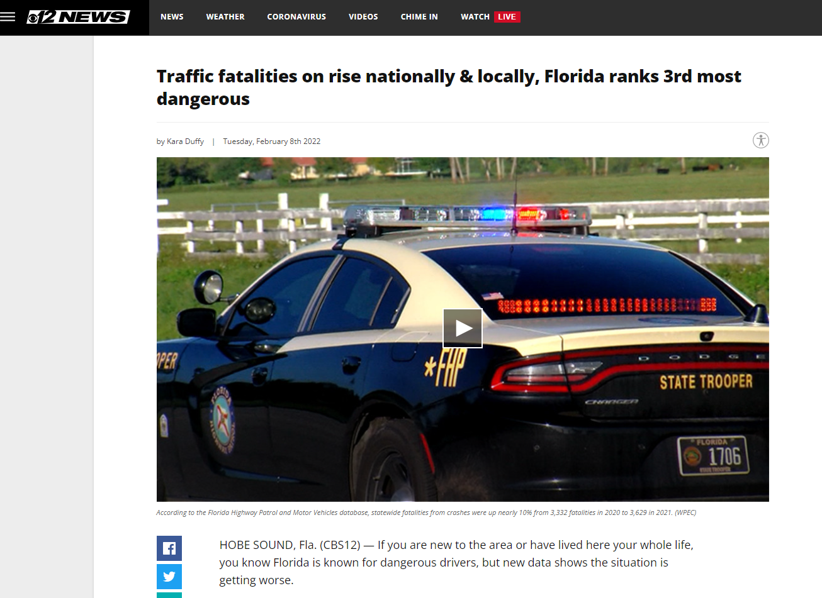
Notes:
Key Message: Florida is consistently ranked as a leading state in F/SI crashes.

Slide 12
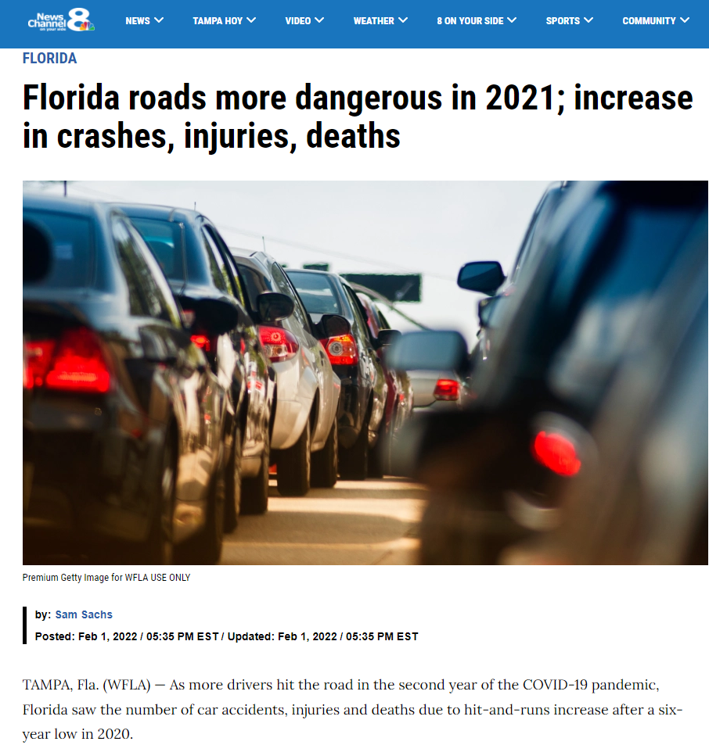
Notes:
Key Message: Another example of the COVID19 effect on transportation crashes.

Slide 13
What else is the State Doing?
Notes:
Key Message: Discuss FDOT’s commitment to improve safety.
Belief that we can reduce and eventually eliminate F/SI crashes.
Effort to align the organization with safety as a primary goal.
EVERY PERSON IS A SAFETY SPECIALIST (why you are participating in this training)
EVERY JOB IS A SAFETY JOB

Slide 14
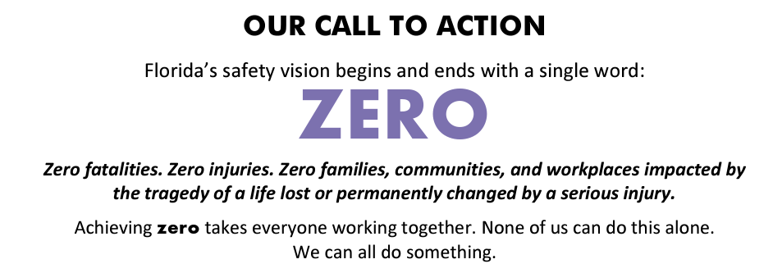
Strategic Highway Safety Plan
Notes:
Key Message: The only option we can have is ZERO.
ZERO fatalities. They only way this works is for every person in their jobs be focused on eliminating fatal and severe injury crashes. These crashes affect thousands of peoples lives
Severe injuries stay with a person for the rest of their lives – amputations, mobility issues, severe scaring, lifelong pain, etc.
This can affect any one of us or our families and loved ones.
We cannot emphasize this enough. Zero is the only number.

Slide 15
Strategic Highway Safety Plan
Notes:
Key Message: Discuss the different groups. Assume that class is not “seasoned” and need each area explained.
Declare that the TOP 3 Emphasis Areas are in Lane Departure, Intersections, and Bike/Ped
We will focus on those three areas in this Academy, and how to solve them, for this reason.

Slide 16
Strategic Highway Safety Plan
Notes:
Key Message: What are Lane Departures?
Leaving the roadway, crossing the center line, improper passing – Any situation when a vehicle leaves its designated lane at an improper time.
42% of deaths is Huge! A third of all crashes and almost half od all deaths. This is a high value place to work to get to ZERO.

Slide 17
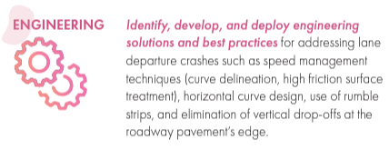
Strategic Highway Safety Plan
Notes:
Key Message: Here are some of the focus strategies for addressing Lane Departure.
Spend time discussing the countermeasures at a high level.

Slide 18
Strategic Highway Safety Plan
Notes:
Key Message: Intersections are locations of planned conflict. We need to work to keep the conflict controlled. The State has recently adopted the ICE process. Intersections such as roundabouts are included. While some low risk collisions can be increased with alternative intersections, or construction of traditional signals, it is the severe crashes that are being reduced and must be focused on.

Slide 19
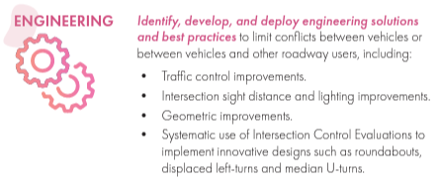
Strategic Highway Safety Plan
Notes:
Key Message: Here are some of the focus strategies for addressing Intersection Crashes.
Spend time discussing the countermeasures at a high level.

Slide 20
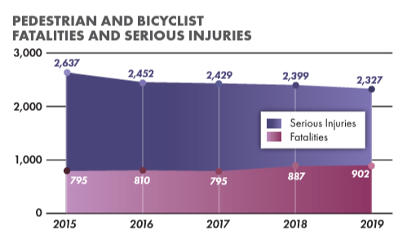
Strategic Highway Safety Plan
Notes:
Key Message: Everyone is a Pedestrian.
Dangerous By Design releases a report each year on Pedestrian Fatalities. Florida was listed as the most dangerous state for pedestrians, and Florida has 7 of the top 10 most dangerous cities for pedestrians.

Slide 21
Strategic Highway Safety Plan
Notes:
Key Message: Here are some of the focus strategies for addressing Bike/Ped safety issues
Spend time discussing the countermeasures at a high level.

Slide 22
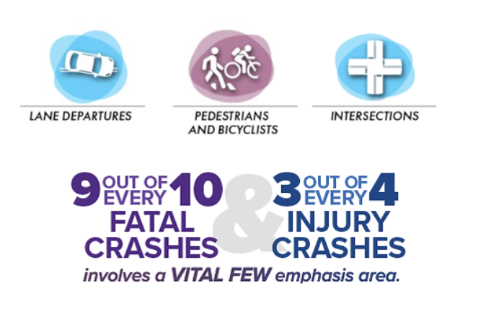
Strategic Highway Safety Plan
Notes:
Key Message: The BIG THREE.
This is why we focus primarily on these three crash safety issues.
These three were named Vital Few Emphasis Areas.
*Take a minute here to ask if anyone has questions and check in with group*

Slide 23
The State Has Adopted Target Zero
Notes:
Key Message: Because the state intends on hitting zero, the state has declared target zero
No matter what it is called, the goal is that no one person is seriously injured or dies on our roadways. You will also hear it referred to as:
Vision Zero – Vision Zero Network
Toward Zero Deaths - Supported by Federal Highway Association, American Association of State Highway Officials (AASHTO) and many State Departments of Transportation
Road to Zero Coalition – Partnership between the National Safety Council, the U.S. Department of Transportation and many other associations and interest groups.
Target Zero - Florida Department of Transportation
Many names, sharing one goal. ZERO!!!!!!
• Is the goal ambitious? Yes
• Do opinions vary on approaches? Yes
• Will there be give and take? Yes
• Will it be stress - free? No
• Will it go as scheduled? No

Slide 24
What is Target Zero?
Target Zero follows the Vision Zero Principles, but makes Zero Deaths a TARGET, and not an aspirational Vision.
Notes:
No notes

Slide 25
What is Target Zero?
Target ZERO is Florida’s safety vision of eliminating all transportation related fatalities and serious injuries for all modes of travel.
Target ZERO provides a framework for Florida’s traffic safety partners to move the needle towards a fatality free transportation system through a safe system approach.
Notes:
No notes

Slide 26
Vision Zero vs Target Zero
Vision Zero vs Target Zero
Vision Zero
Vision zero sets the goal of eliminating all traffic fatalities and severe injuries, while increasing safe, healthy, equitable mobility for all, in a set period with clear, measurable strategies.
Traffic deaths are PREVENTABLE
Acknowledge HUMAN BEHAVIOR influences crashes
Multidisciplinary approach
https://visionzeronetwork.org
Target Zero
Target Zero is a parallel effort that plans programs and projects, both infrastructure and behavioral related, to help achieve zero fatalities and serious injuries.
Vision Zero is a part of Target Zero
Notes:
Key Message: Additionally….
Target Zero adds a behavioral component that Vision Zero acknowledges but does not pursue.
Essentially, VZ is an outlook on how to approach the safety issues, Target Zero is the implementation

Slide 27
Why is Achieving Zero Fatalities Important?
Notes:
Key Message: (After video plays)
In this video, the gentleman thinks serious injuries and deaths on our roads were acceptable, until it became about his friends and loved ones.
The reality is, the next crash “could” be our friends or loved ones. We have to change the way we think, every single person is important to someone.
Earlier I asked the questions, is this goal of zero ambitious?, are there different opinions on how to get there?, will we have to compromise? Will it come without stress or go as scheduled?
Here are the important questions we should be asking…..
Can we honestly say that having even one person dying on our roadways is acceptable?
Are we willing to work together to effect real change?

Slide 28
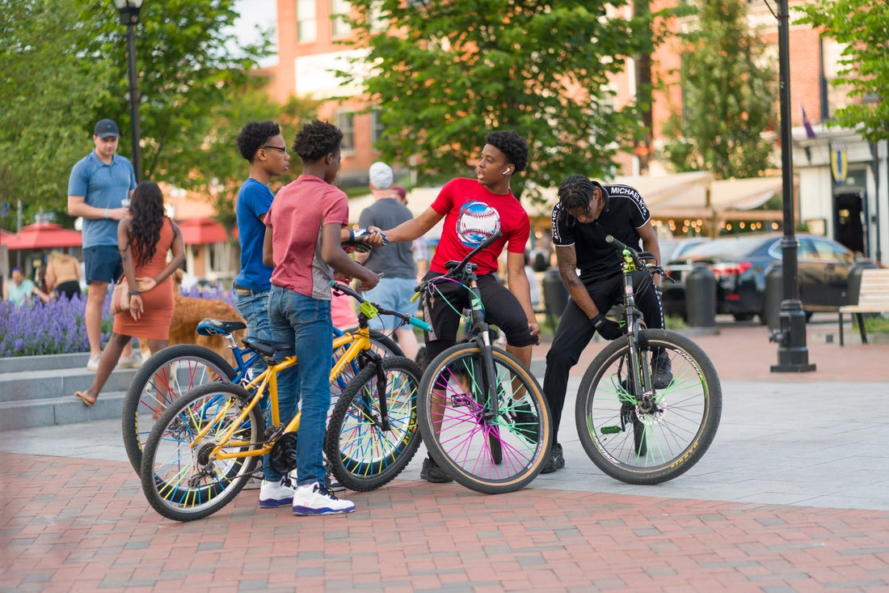
Imagine our country as a place where nobody has to die from vehicle crashes.
Notes:
Key Message: Let’s take a moment to reflect on the reason we are here today: each day, people are killed and seriously injured on our roads. Crashes can irreversibly change the course of human lives, touching victims, their families and loved ones, and society as a whole. But death and serious injury do not have to be consequences we live with simply to use our roadway system. Through collective action on the part of all roadway system stakeholders—from system managers and vehicle manufacturers, to law enforcement and everyday users—we can move to what’s called the Safe System approach that first anticipates human mistakes and second keeps impact energy on the human body at tolerable levels—with the goal of eliminating fatal & serious injuries for all road users.

Slide 29
How does the United States reach zero deaths?
Notes:
Key Message: Imagine in the coming decades that not a single person in the United States dies in a traffic crash. Thinking about safety this way requires a paradigm shift in how we perceive the problem. Rather than accepting fatalities and serious injuries as a price for mobility, the philosophy of the Safe System approach is grounded in an ethical imperative that no one should be killed or injured when using the roadway system. We will discuss the something called the Safe System approach in upcoming slides
Interactivity: No interactivity for this slide.
Notes: No notes for this slide.

Slide 30
Why Not Vision Zero?
“Roadway tragedies effect real people and leave behind nothing less than devastation. The social, emotional and economic impact to our communities is vast. Increasing safety, healthy and equitable mobility for all positively impacts our communities by saving human lives.”
- Melissa Wandall
2020 Florida Crashes
Serious Injury 15,614 | Fatal 3,332
Approximate Average: 43 people a day | Approximate Average: 9 people a day
Notes:
Key Message: Stop here again to remind folks of the cost. Why its worth addressing this issue.
Interactivity: Ask how many people have been in a bad wreck, or knew someone else that had. Ask how many have teenagers that drive, or kids that they carry with them.
Notes: No notes for this slide.

Slide 31
What is Vision Zero?
Notes:
Key Message: Remember, Vision Zero is a core philosophy of Target Zero. It is also a foundation of the Safe Systems Approach.

Slide 32
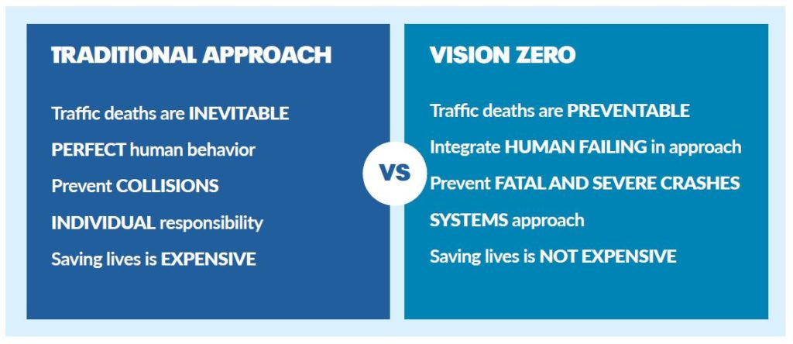
How is Vision Zero Different?
Notes:
Key Message: Compare and contrast the approaches
Emphasize that we do not have “Fantasy Drivers” and “Fantasy Pedestrians” and must design for humans failing
Vision Zero requires system designers to take responsibility for crashes.
A belief that we CAN make a difference

Slide 33
How Do We Apply Target Zero?
Safe System
Notes:
Interactivity: Ask the audience how familiar they are with the Safe System approach.
The Safe System Approach is how Vision Zero and Target Zero are applied.
Background: The Safe System approach is a global movement that has been in place in countries across the globe for more than 30 years. The Federal Highway Administration’s (FHWA) top priority is safety, and for this reason it fully supports the vision of zero deaths and serious injuries on the Nation’s roadway system. While the Safe System approach is new to the United States, it is worth mentioning that the majority of the States have adopted a zero deaths approach (also known as Toward Zero Deaths (TZD)), and more than 50 communities across the United States have adopted Vision Zero initiatives that set a goal of eliminating fatal and serious injuries from the roadway system. TZD and Vision Zero provide opportunities to adopt Safe System, and some States and localities have already adopted the Safe System approach.
Notes: Additional information on the FHWA Safe System approach is available at https://safety.fhwa.dot.gov/zerodeaths/

Slide 34
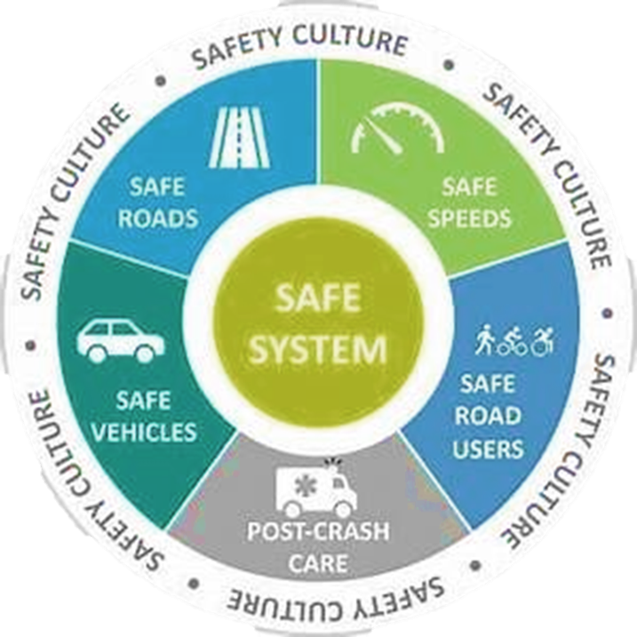
A Safe System Approach
Safe Roads
Safe Speeds
Safe Road Users
Post Crash Care
Safe Vehicles
Preventing Serious Injury and Fatal Crashes
is Everyone’s Responsibility
Notes:
Key Message: A Safe System Approach is the “road map” to the goal of zero. Instead of looking at a problem intersection, a particular stretch of roadway or spot enforcement campaigns, a safe system looks at all the listed categories to design a safer roadway system. You will be hearing much more on the Safe System Approach today.
The Safe System approach aims to eliminate fatal & serious injuries for all road users. It is a holistic view of the road system that anticipates human mistakes and tries to create a roadway that will lessen impacts making crashes more survivable.
Safe Roads – Roadways need to be designed expecting that human make mistakes. Roundabouts, which reduce the angle of impact or separated facilities for people walking or biking can significantly reduce the severity of injuries on our roadways.
Safe Speeds – Speed is a factor in many fatal or serious injury crashes. Speed management through roadway design or enforcement (including automated enforcement) is vital to reducing serious injury and fatalities.
Safe Road Users - The Safe System approach addresses the safety of all road users, including those who walk, bike, drive, ride transit, and travel by other modes.
Education and Outreach for all users (safety campaigns)
Safe Vehicles – New vehicle technology is advancing rapidly. Newer vehicles are equipped with technology that help them minimize occurrences and severity of crashes.
Automatic braking, collision avoidance, lane departure warnings
Post Crash Care – First responder post crash care is essential to avoid preventable death and disability and limit the severity of the injury

Slide 35
A New Direction
The Safe System approach aims to eliminate fatal and serious injuries for all road users by:
Accommodating human mistakes
Keeping impacts on the human body at tolerable levels
Notes:
Key Message: The Safe System approach aims to eliminate fatal and serious injuries for all road users by accommodating human mistakes and keeping impacts on the human body at tolerable levels. This is the fundamental objective of the Safe System approach. What separates the Safe System approach from the traditional approach to safety is the ethical imperative that not even one death is acceptable in our roadway system. The next slide provides a bit of brief background on the Safe System approach.
Notes: Examples of accommodating human mistakes include roadway design features like rumble strips, which alert a driver when they are unintentionally departing the roadway, or vehicle design features like autonomous emergency braking, which activate to stop the vehicle when the driver may not be able to do so. Examples of keeping impacts on the human body at tolerable levels include measures to control speed, physically separating users travelling at different speeds (e.g. drivers and people riding bikes), and vehicle safety features like seatbelts and airbags.

Slide 36
Successful Safe System Adopters
Sweden
Vision Zero
60-70% Reduction in fatalities 1994-2015
Netherlands
Sustainable Safety
50-60% Reduction in fatalities 1994-2015
Australia
Safe System
50-60% Reduction in fatalities 1994-2015
New Zealand
Safer Journeys
50-60% Reduction in fatalities 1994-2015
Source: World Resources Institute
Notes:
Key Message: The Safe System approach is not a new concept. It has existed for more than 30 years in countries across the globe. Each of the early adopters of the Safe System approach, shown on this slide, has seen marked decreases in traffic fatalities across their roadway systems—each with at least a 50% reduction in fatalities. During the same period, fatalities in the US were only reduced by 11%. The Safe System approach is how these countries moved off the “plateau” of safety to start achieving significant reductions. These examples show promise that, by implementing a Safe System approach in the United States, we may be able to achieve meaningful reductions in traffic deaths. Indeed, the US has started implementing a Safe System through various initiatives, which we’ll discuss on the following slide.
Interactivity: No interactivity for this slide.
Background: Data are from the World Resources Institute 2018 report Sustainable and Safe: A Vision and Guidance for Zero Road Deaths: https://www.wri.org/publication/sustainable-and-safe-vision-and-guidance-zero-road-deaths
Notes: Countries that have adopted a Safe System approach have both the lowest rates of fatalities per 100,000 inhabitants and the fastest rate of change in fatality levels.

Slide 37
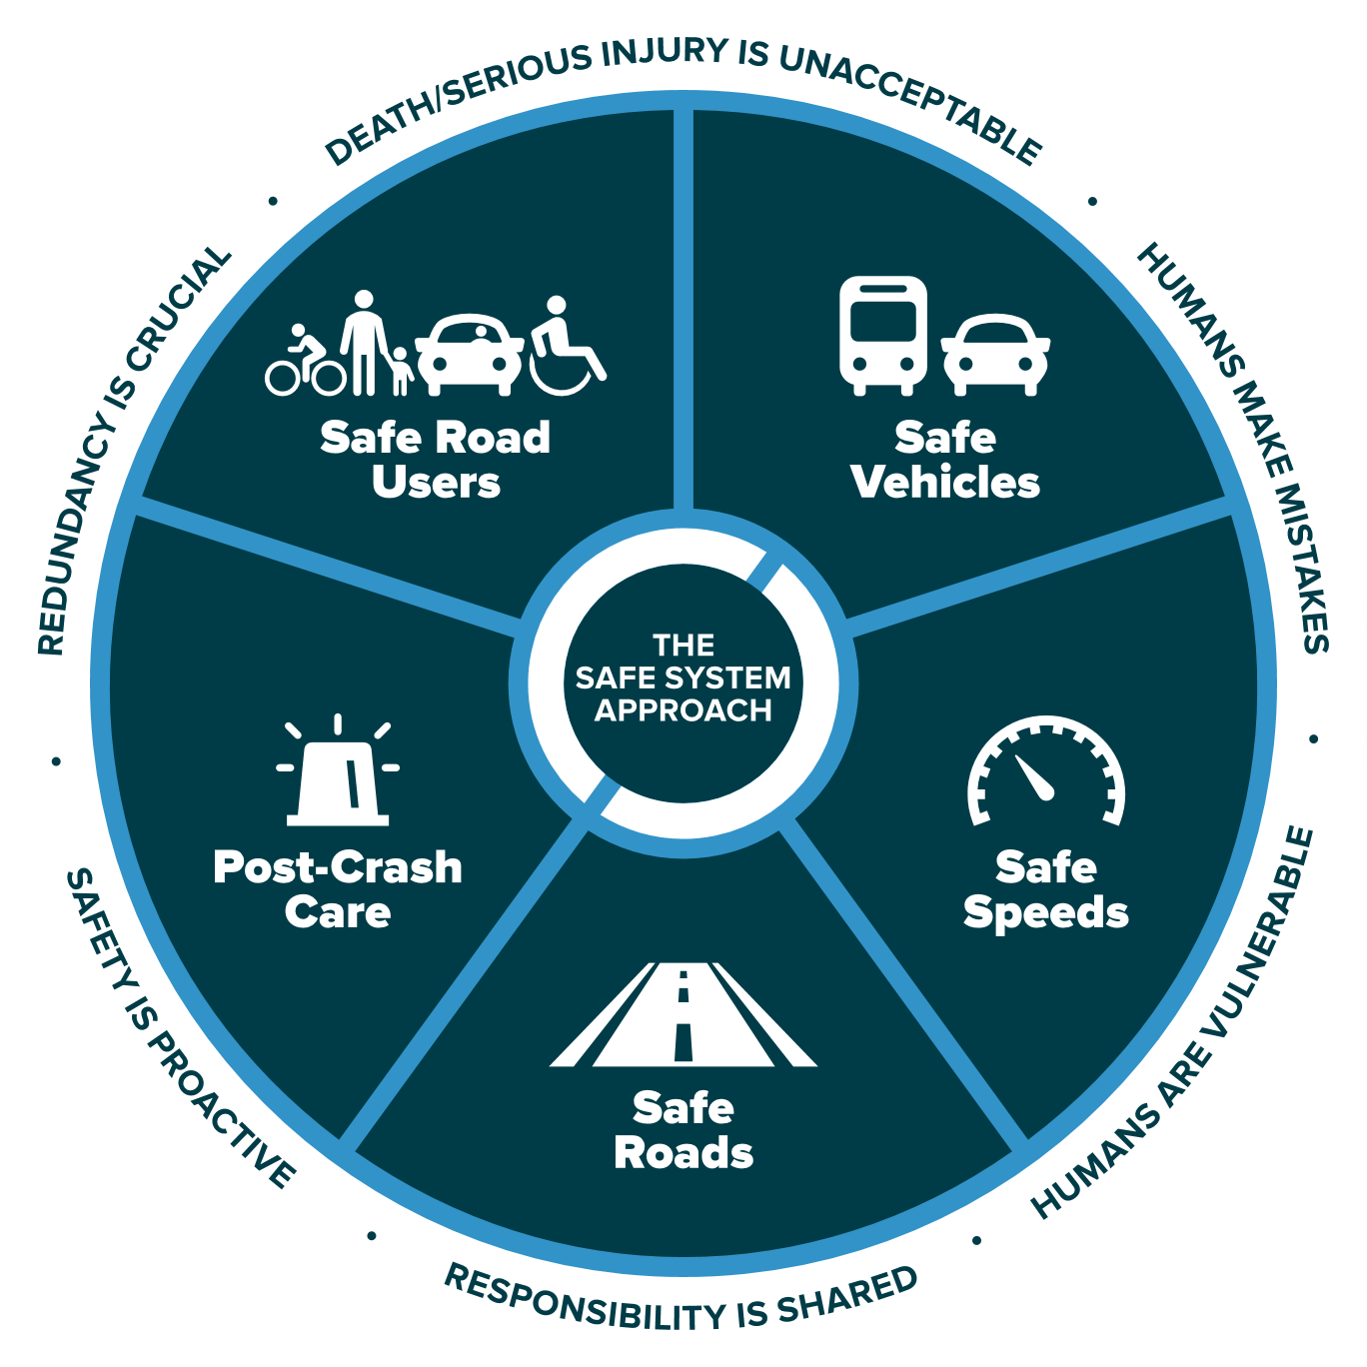
The
Safe
System
Approach
Source: FHWA
Notes:
Key Message: This graphic presents an overview of the Safe System approach. There are three key components to understand, which will be explained on this and the following slides. These are the Safe System “approach,” “principles,” and “elements.” The Safe System “approach,” shown by the graphic on this slide, is the broadest term and describes all aspects of the Safe System.
In addition, the term “Safe System” is singular to depict an overall Safe Road System. The National Safety Council and our international partners also use this version.
Interactivity: No interactivity for this slide.
Background: This graphic was created for FHWA drawing inspiration from similar designs by the Institute of Transportation Engineers (ITE), the Road to Zero Coalition, and the Royal Society for the Prevention of Accidents (ROSPA) in the United Kingdom.
Notes: No notes for this slide.

Slide 38
The
6 Safe
System
Principles
Source: FHWA
Notes:
Key Message:
Death/Serious Injury is Unacceptable – We eliminate the discussion of “There was only one.. (crash)” and “There’s nothing we can do”
Humans Make Mistakes – How do we design the system so there is forgiveness not IF, but WHEN, someone makes a mistake?
Humans are Vulnerable – Speed Kills. The Human body can only take so much punishment. Lower speeds to increase survivability.
Responsibility is shared – Human Behaviors CAN be influenced through design. We share responsibility in the crashes that happen on our system by having designed them.
Safety is Proactive – We do not wait for crashes to happen before we design the system to be safer. We make changes whenever we can to try to avoid a life altering event from ever happening.
Redundancy is Crucial – Work to put multiple levels of protection in place to protect people. If one fails, the rest will succeed.

Slide 39
The
5 Safe
System
Elements
Source: FHWA
Notes:
Key Message: The five Safe System “elements,” highlighted in the middle ring of the graphic, are conduits through which the Safe System approach must be implemented. The key focus of the Safe System approach is to reduce death and serious injuries through design that accommodates human mistakes and injury tolerances. Making a commitment to zero deaths means addressing every aspect of crash risks through the five elements of a Safe System. These layers of protection and shared responsibility promote a holistic approach to safety across the entire roadway system. The five elements will be discussed in depth later in the presentation.
Interactivity: No interactivity for this slide.
Background: No background for this slide.
Notes: No notes for this slide.

Slide 40
The 6 Safe System Principles
Death/serious injury is unacceptable
Humans make mistakes
Humans are vulnerable
Responsibility is shared
Safety is proactive
Redundancy is crucial
Notes:
Key Message: The six Safe System “principles” are the fundamental beliefs that the approach is built on. They establish the goal of the Safe System approach, acknowledge human limitations, and set expectations for how to act. They will be explained one-by-one on the following slides.
Interactivity: Ask whom in the audience recognizes any of these.
Background: These six principles are based on a framework developed by other Safe System adopters outside the United States, including Sweden, the Netherlands, Australia, and New Zealand.
Notes: No notes for this slide.

Slide 41
Death/serious injury is unacceptable
Source: Vision Zero Network
Notes:
Key Message: The first principle is that death and serious injury is unacceptable. While no crashes are desirable, the Safe System approach prioritizes crashes that result in death and serious injuries, since no one should experience either when using the roadway system. The goal is to modify how users, vehicles, transportation infrastructure, and emergency response operate to reduce the likelihood of crashes happening at all, and to reduce their severity when they do happen.
Interactivity: No interactivity for this slide.
Background: The image shows a memorial to people killed in traffic crashes.
Notes: This Toward Zero Deaths video is an option for speakers (note that it is 3:44 minutes long): https://youtu.be/_AIubBHtz7g

Slide 42
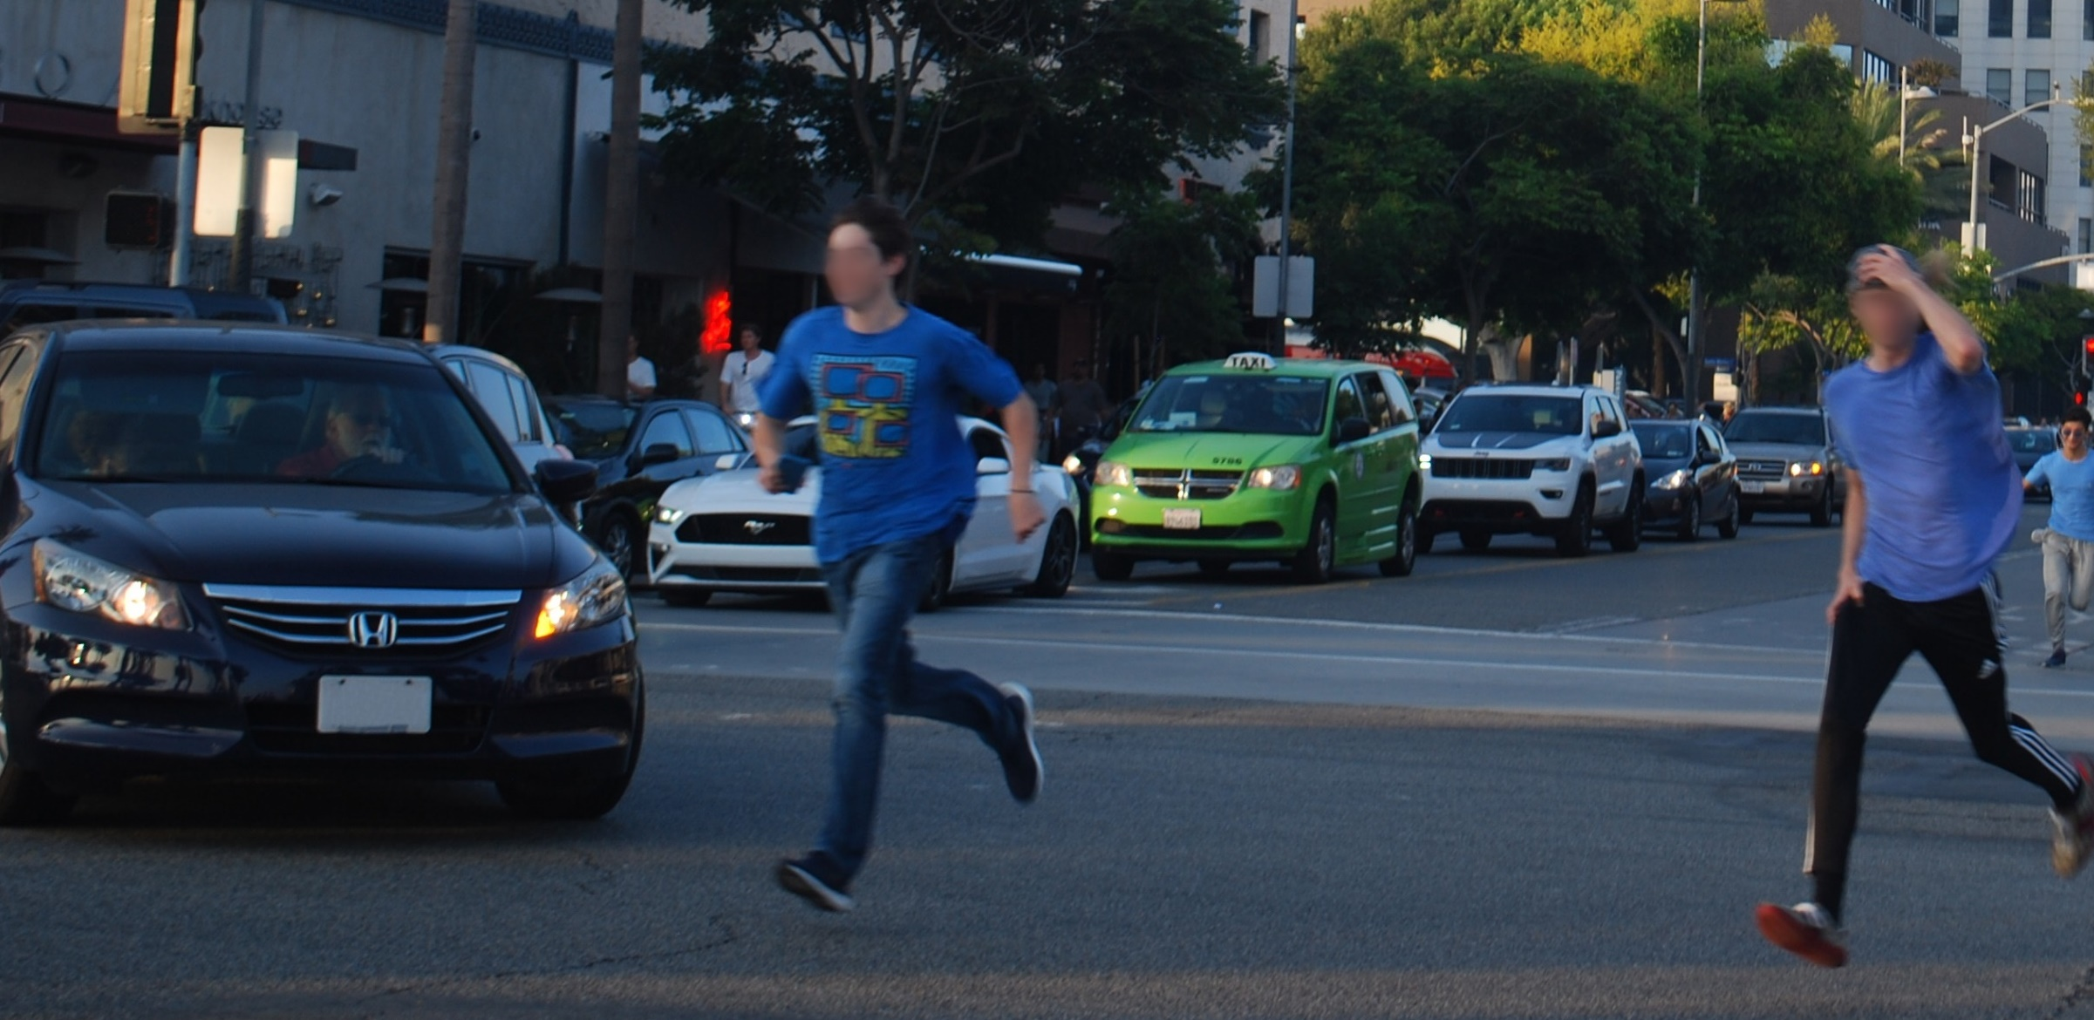
Humans make mistakes
Source: Fehr & Peers
Notes:
Key Message: The next principle is that humans make mistakes. People will inevitably make mistakes that can lead to crashes, but we can design and operate the roadway system to accommodate human mistakes to avoid death and serious injuries.
Interactivity: No interactivity for this slide.
Background: The image shows two people making a mistake by violating traffic rules and risking a collision.
Notes: An example of designing a roadway to accommodate human mistakes is adding a median to prevent errant drivers from entering oncoming traffic.

Slide 43
Humans are vulnerable
Fatality
100%
Fatality Risk
Serious Injury
0%
Crash Kinetic Energy
Source: FHWA
Notes:
Key Message: The next principle is that humans are vulnerable. As the chart shows, people have a limited ability to tolerate crash impacts before death and serious injuries occur. Human tolerance to crash impacts is central to the Safe System approach. The management of kinetic energy transfer to within survivable limits is important for understanding how to design and operate the road system consistently with the Safe System philosophy. The Safe System approach focuses not just on managing speed but managing transfer of kinetic energy.
Interactivity: No interactivity for this slide.
Background: The graphic was created for FHWA to explain the concept that as crash kinetic energy increases, so too does the potential of serious injury and death. It does not take particularly high kinetic energy levels for the potential of serious injury to occur.
Notes: No notes for this slide.

Slide 44
Responsibility is shared
System managers
Planners, designers, builders, operators, maintenance workers
Vehicle manufacturers
Law enforcement personnel
Post-crash personnel
System users
Notes:
Key Message: The next principle is that responsibility is shared. System managers, vehicle manufacturers, law enforcement, post-crash personnel, and system users all have a responsibility to promote safe behavior and ensure that crashes don’t lead to fatal or serious injuries.
Interactivity: No interactivity for this slide.
Background: No background for this slide.
Notes: Examples include system managers designing facilities with proven safety countermeasures, like roundabouts or median barriers; system managers keeping roadway systems in good state of repair; vehicle manufacturers applying the latest safety features in vehicles; law enforcement equitably enforcing traffic safety laws; and users of all travel modes safely moving through the roadway system. “System managers” includes planners, designers, builders, operators, and maintenance.

Slide 45
Safety is proactive
Identify risks
Mitigate risks
Notes:
Key Message: The next principle is that safety is proactive. In addition to crash-based analysis, transportation agencies should use proactive tools to identify and mitigate latent risks in the roadway system, rather than waiting for crashes to occur and reacting afterwards. This process, known as the Systemic Approach to Safety, uses crash history, roadway design, and other data to identify patterns in geometric design that lead to certain crash types. System designers then identify appropriate countermeasures to mitigate the crash types. These countermeasures are systemically applied at all locations meeting the particular geometric design, irrespective of crash history. Rather than managing risk at certain locations, a systemic approach takes a broader view and evaluates risk across an entire roadway system. A system-based approach acknowledges crashes alone are not always sufficient to determine what countermeasures to implement, particularly on low-volume local and rural roadways where crash densities are lower, and in many urban areas where there are conflicts between vehicles and vulnerable road users (pedestrians, bicyclists, and motorcyclists).
Interactivity: The speaker may want to facilitate a discussion among the audience: "I have limited funds. How can I justify addressing latent risks when I have other locations with a history of crashes? I don't have funding to do both.“
Background: No background for this slide.
Notes: Additional information on the Systemic Approach to Safety is available at https://safety.fhwa.dot.gov/systemic/

Slide 46
Redundancy is crucial
Safe road users
Safe vehicles
Safe speeds
Safe roads
Post-crash care
Notes:
Key Message: The final principle is that redundancy is critical. Reducing risks requires that all parts of the roadway system are strengthened, so that if one part fails, people are still protected. This is the last of the six Safe System principles. The next section will address the five Safe System elements.
Interactivity: Ask the audience if they have questions about the principles.
Background: No background for this slide.
Notes: An example of redundancy is rumble strips, which protect people when their own ability to be safe road users is compromised by distraction or drowsiness.

Slide 47
The 5 Safe System Elements Create Redundancy
The “Swiss Cheese Model” of redundancy creates layers of protection
Death and serious injuries only happen when all layers fail
Safe road users
Safe road users
Safe vehicles
Safe vehicles
Safe speeds
Safe speeds
Safe roads
Safe roads
Post-crash care
Post-crash care
Notes:
Key Message:
The left graphic shows how five Safe System elements work together, such that if one part fails, there are redundant systems in place. The “Swiss Cheese Model” helps demonstrate this redundancy. Layered safety measures are represented as slices of swiss cheese with the holes being weaknesses in individual parts of the system. The holes represent weakness causing failures or latent condition. When the cheese slices act as successive layers of defenses and the holes are not lined up, a person is protected.
The right graphic shows that a failure only results when a hole in each slice momentarily aligns, permitting a hazard to pass through holes in all the slices. The basic principle is that lapses and weaknesses in one part of the system can occur, but other parts compensate to not allow a failure. This relates back to the Safe System principles that redundancy is critical and responsibility is shared.
We’ve now discussed all six Safe System principles and all five Safe System elements. The next section of the presentation focuses on Safe System case studies.
Interactivity: Optional break for questions.
Background:
The “Swiss Cheese Model” is applicable to numerous risk management fields and was originally espoused by Dante Orlandella and James T. Reason of the University of Manchester. The graphic was adapted for FHWA from their work to explain the redundancy of the five Safe System elements.
We showed the previous slide where all the holes are lined up, meaning redundancy isn’t there. This slide shows cheese slices with the holes not lined up and how redundancy works.
Notes: A good example of how the five Safe System elements work together to create redundancy is distracted driving. Education campaigns focused on alert driving—avoiding behaviors like texting while driving—help create safe road users. Vehicle safety systems, like lane departure warnings, create safe vehicles that alert distracted drivers to potential hazards. Enforcement can help maintain safe speeds, so that if an incident should occur due to distracted driving, impact forces on the human body remain within tolerable levels. Infrastructure like rumble strips creates safe roads and an additional layer of redundancy to warn distracted drivers about a potential roadway departure. Sometimes, all these measures are not enough to prevent a distracted driving crash from occurring, but efficient, rapid post-crash care can help this mistake not be fatal.

Slide 48
Where are You on the Safe System Journey?
Traditional Approach
Safe System Approach
Prevent crashes
Prevent death and serious injuries
Improve human behavior
Design for human mistakes/limitations
Control speeding
Reduce system kinetic energy
Individuals are responsible
Share responsibility
React based on crash history
Proactively identify and address risks
Notes:
Key Message: As we’ll see in the text that appears on the slide, implementing the Safe System approach requires moving away from several traditional safety paradigms.
Animation 1: Rather than preventing crashes, the Safe System approach seeks to prevent death and serious injuries
Animation 2: In addition to trying to improve human behavior, the Safe System approach designs for human mistakes and limitations
Animation 3: While the traditional safety approach focuses on controlling speeding, the Safe System approach attempts to reduce system kinetic energy
Animation 4: Rather than asserting that only individuals are responsible, the Safe System approach aims to share responsibility among system users, managers, and others
Animation 5: Instead of reacting based on crash history, the Safe System approach proactively identifies and addresses risks
Implementing the Safe System approach is our shared responsibility, and we all have a role. The next slide introduces FHWA resources to help agencies implement the Safe System approach.
Interactivity: This slide has 5 animations that require the speaker to click through each one at a time.
Background: No background for this slide.
Notes: The Safe System approach encompasses the elements of the 4Es (Enforcement, Education, Emergency Response, and Engineering). It refocuses efforts on reducing death and serious injury through accommodating human mistakes and reducing impact forces to tolerable levels.

Slide 49
FHWA Resources
Safe System Materials
Find more resources at: safety.fhwa.dot.gov/zerodeaths
Notes:
Key Message: FHWA is developing resources to help agencies implement the Safe System approach. FHWA currently offers Safe System outreach materials in addition to this presentation. The agency is working to integrate the Safe System approach and has released a number of reports related to linking the approach to programs such as HSIP/SHSP, intersection safety, speed management, and pedestrian and bicycle safety. They can be found on the FHWA Zero Deaths website, linked on the slide. The website provides resources on the Safe System approach as well as related approaches and strategies. Beyond FHWA, the three initiatives mentioned earlier in the presentation—Road to Zero Coalition, Toward Zero Deaths, and Vision Zero Network— and ITE offer additional resources for agencies looking to bring a Safe System approach to their community.
Interactivity: No interactivity for this slide.
Background: No background for this slide.
Notes: No notes for this slide.

Slide 50
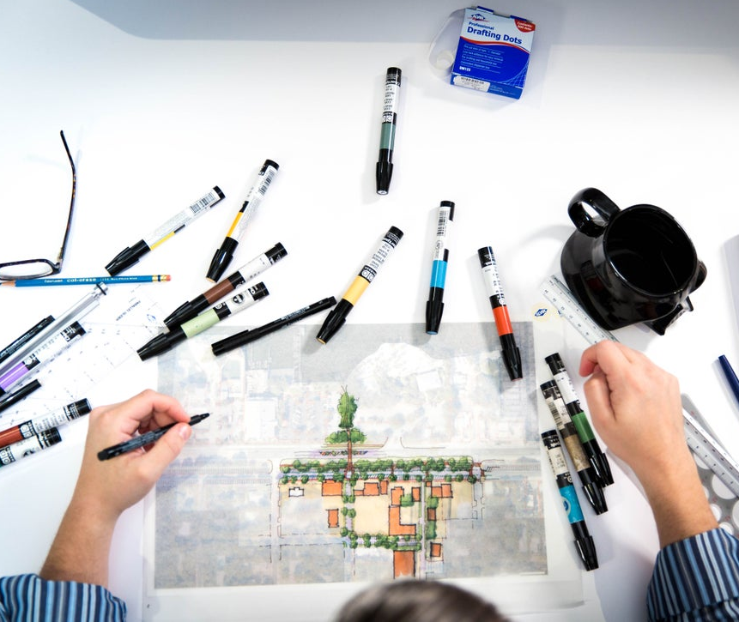
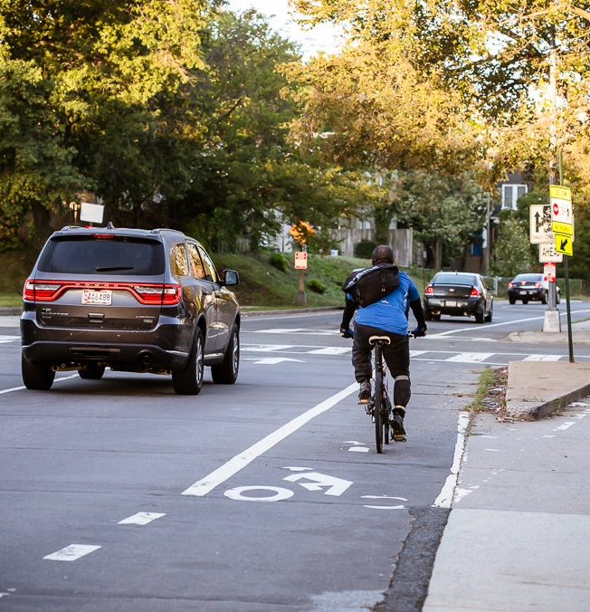
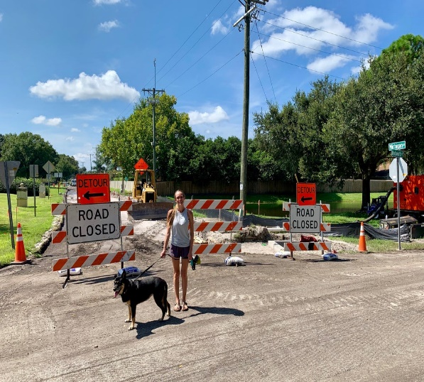
Implementing the Safe System approach is our shared responsibility, and we all have a role.
Notes:
Key Message: As we wrap up the presentation, it’s important to remember that road safety is truly a matter of life and death. To get the best result, zero deaths, we must integrate the safe system approach to our safety framework. We need to work together, and our system needs to work together, to get to zero. Achieving a future with zero traffic deaths requires a Safe System approach—shifting how we think about road safety and how we prioritize our investments. Consider applying a Safe System lens to upcoming projects and plans in your community: put safety at the forefront and design to accommodate human mistakes and injury tolerances. As transportation professionals, road safety is in our hands. We have the power to achieve a Nation where nobody has to die from vehicle crashes. At this point, we’ve reached the end of the presentation and can take any questions you have.
Interactivity: Consider what a Safe System approach means for your agency and areas of responsibility. What might a Safe System lens look like for an upcoming project or plan? How might a Safe System approach change your work? For example, more collaboration with operational safety agencies, EMS, public health, etc.
Background: No background for this slide.
Notes: No notes for this slide.

Slide 51
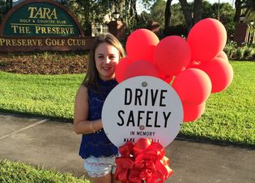
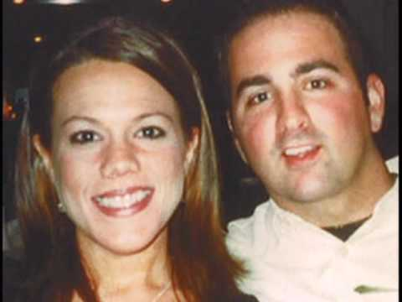
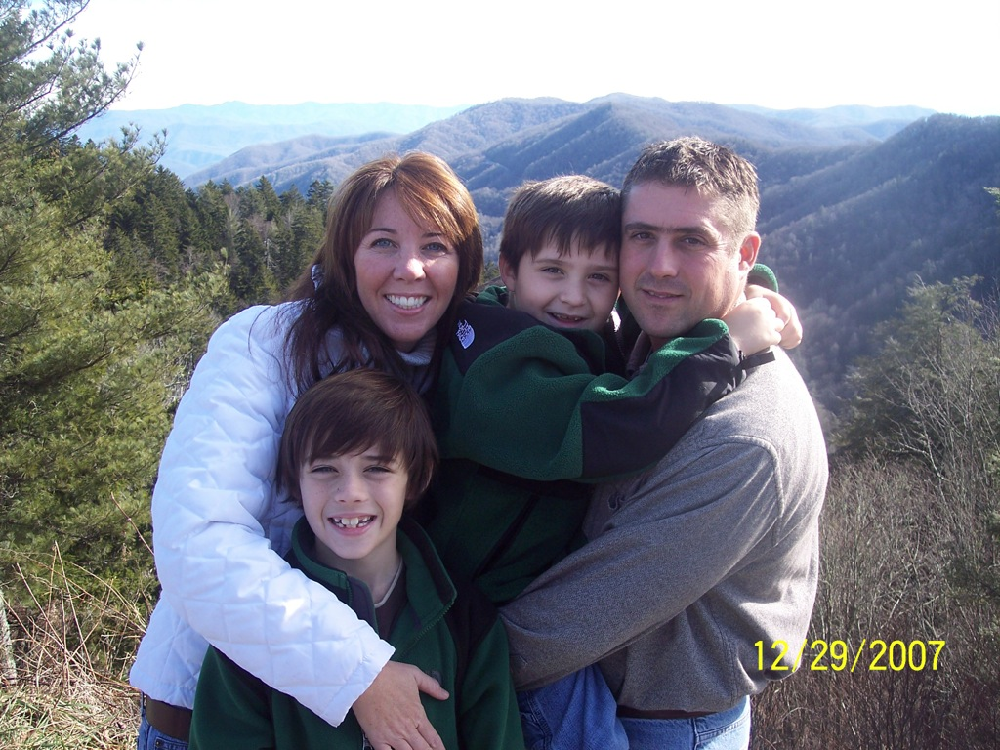
Traffic
Fatalities
are
Preventable
Notes:
Key Message: Remember that people don’t have to die on our systems. We can prevent these crashes with the work that we do here.

Slide 52
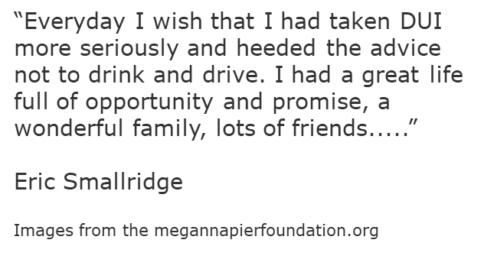
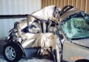
Good People Make Bad Choices
Notes:
Key Message:
Good people make life altering decisions
Road users overestimate their abilities
Those seriously injured or killed are not the only victims of traffic crashes
We often consider the victims family, friends, and co-workers, but let this serve as a reminder that the driver is also a victim of their own choices

Slide 53
What else is the State Doing?
Notes:
Key Message: We are going to wrap up today by talking about some of the initiatives that the state is working on

Slide 54
What else is the State Doing?
Notes:
Key Message: Strategic highway Safety Plan

Slide 55
What else is the State Doing?
Vital Few Safety
Notes:
Key Message: Secretary Thibeau started the Vital Few Initiatives. Among them was the Vital Few Safety Team. Professionals across the state were included and asked to solve the Top 3 Safety Emphasis areas : Lane Departure, Bike/Ped, and Intersection Crashes. The teams developed strategies to work on implementing around the state. Already you can see the results in things like the re-write of FDM 114 to include safety items in RRR projects, or in the statewide Safety Needs Dashboard. This academy was even identified as a major strategy.

Slide 56
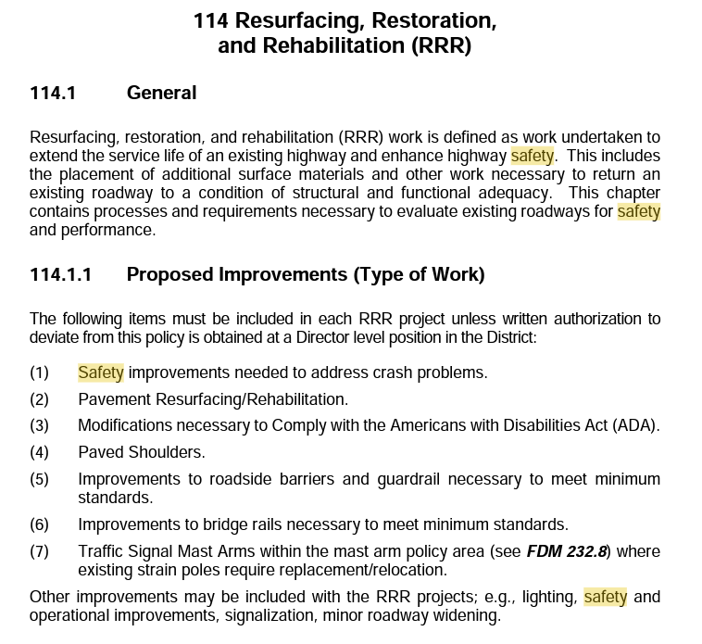
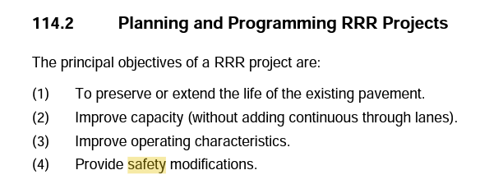
What else is the State Doing?
Notes:
Key Message: The state is re-writting or creating new manuals. As you can see, the State has re-written FDM 114 to ensure Safety is a critical component to our RRR Program. The State wants to ensure that the safety of the public is being considered at every step of a project. Safety is a primary goal of the Department.
Some units, such as PD&E have new manuals dedicated to safety evaluations in projects.

Slide 57
What else is the State Doing?
Creating an Organization full of Safety Specialists!
Notes:
Key Message: This is each of you! All of you here will be equipped to solve our most common problems. The State expects every one of you to apply what you learn and make every project a safety project.

Slide 58
What else is the State Doing?
Notes:
How Can You Apply What We Discussed Today?
How Will You Help Reduce Life Altering Crashes?
Remember, our goal is ZERO.
• Is the goal ambitious? Yes
• Do opinions vary on approaches? Yes
• Will there be give and take? Yes
• Will it be stress - free? No
• Will it go as scheduled? No

Slide 59
Thank You!

Slide 60
Brand Icons: Black
Black Icons (right click to copy)
Use When Representing:
bikers
bike/ped combined
intersections
pedestrians

Slide 61
Brand Icons: White
Black Icons (right click to copy)
Use When Representing:
bikers
bike/ped safety
intersections
pedestrians

