Slide 1


District One Advanced Traffic Safety Academy
Presented by: Larry Hagen, P.E., PTOE, RSP
Session 3 – Advanced Unsignalized
Intersection Safety Treatments

Slide 2
Advanced Traffic Safety Academy
Florida’s SHSP Update
Advanced Unsignalized Intersection Safety Treatments
Advanced Signalized Intersection Safety Treatments
NCHRP 500
Safe Systems Approach
Hot-Button Safety Review
Innovative Intersection Designs
Combining Safety Countermeasures
Human Factors in Highway Safety
Safety Evaluation Workshop
Safety Evaluation Workshop
Building a Safety Culture

Slide 3
Advanced Traffic Safety Academy
Florida’s SHSP Update
Advanced Unsignalized Intersection Safety Treatments
Advanced Signalized Intersection Safety Treatments
NCHRP 500
Safe Systems Approach
Hot-Button Safety Review
Innovative Intersection Designs
Combining Safety Countermeasures
Human Factors in Highway Safety
Safety Evaluation Workshop
Safety Evaluation Workshop
Building a Safety Culture

Slide 4
NCHRP 500 Series
Volume 5: A Guide for Addressing Unsignalized Intersection Collisions

Slide 5
Fatal Crashes by Location

Slide 6
Objectives of This Emphasis Area
Improve management of access near unsignalized intersections
Reduce the frequency and severity of intersection conflicts through geometric design improvements
Improve sight distance at unsignalized intersections
Improve availability of gaps in traffic and assist drivers in judging gap sizes at unsignalized intersections
Improve driver awareness of intersections as viewed from the intersection approach
Notes:
Continues on next slide

Slide 7
Objectives of This Emphasis Area (cont.)
Choose appropriate intersection traffic control to minimize crash frequency and severity
Improve driver compliance with traffic control devices and traffic laws at intersections
Reduce operating speeds on specific intersection approaches
Guide motorist more effectively through complex intersections

Slide 8
Objectives and Strategies for Improving Safety at Unsignalized Intersections
Notes:
Objective A
Remember what the designations here represent: T=Tried; P=Proven; E=Experimental

Slide 9
Objectives and Strategies for Improving Safety at Unsignalized Intersections
Notes:
Objective B
Continues on next 2 slides – 18 different strategies for Objective B

Slide 10
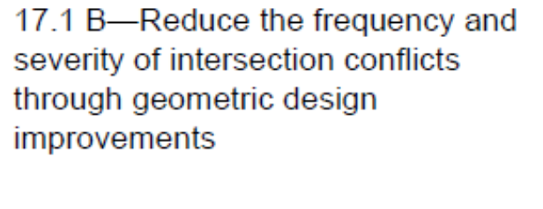
Objectives and Strategies for Improving Safety at Unsignalized Intersections
Notes:
Continues some more on the next slide

Slide 11
Objectives and Strategies for Improving Safety at Unsignalized Intersections

Slide 12
Objectives and Strategies for Improving Safety at Unsignalized Intersections
Notes:
Objective C

Slide 13
Objectives and Strategies for Improving Safety at Unsignalized Intersections
Notes:
Objective D

Slide 14
Objectives and Strategies for Improving Safety at Unsignalized Intersections
Notes:
Category E
Continues on next slide

Slide 15
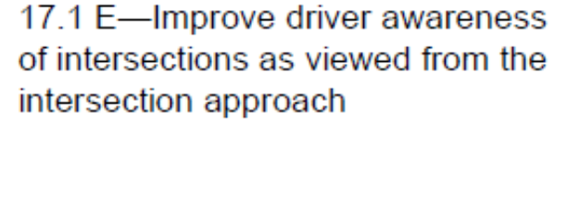
Objectives and Strategies for Improving Safety at Unsignalized Intersections

Slide 16
Objectives and Strategies for Improving Safety at Unsignalized Intersections
Notes:
Objective F

Slide 17
Objectives and Strategies for Improving Safety at Unsignalized Intersections
Notes:
Objective G

Slide 18
Objectives and Strategies for Improving Safety at Unsignalized Intersections
Notes:
Objective H

Slide 19
Objectives and Strategies for Improving Safety at Unsignalized Intersections
Notes:
Objective I

Slide 20

Questions?

Slide 21
Unsignalized Intersection Safety
Can we get some more details on these countermeasures?

Slide 22
Manner of Collision for Fatal Unsignalized Intersection Crashes
Vehicle
Notes:
This figure shows that the manner of collision is typically a collision with a motor vehicle in transport.

Slide 23
Other safety issues at unsignalized intersections:
Diverse geometric design and traffic control features of intersections;
Diverse vehicle population, including a wide range of vehicle sizes and weights;
Diverse driver populations, including anticipated demographic changes;
Weather-related problems, such as wet and ice-and-snow-covered pavements; and
Wide range of traffic volumes on intersection approaches, with patterns of daily and seasonal variations.
Notes:
[after showing them all] Of these attributes, only geometric design and traffic control features (the first bullet) are under the direct control of highway agencies.

Slide 24
Notes:
There is a LOT more info in the NCHRP 500 than what we will cover in this session. This is an example of a portion of a table that shows the implementation timeframe and relative cost for the identified countermeasures.

Slide 25
Notes:
This is another table in the NCHRP 500 that describes the attributes for each strategy. It tells you what the target locations are, the expected effectiveness, the keys to success, potential difficulties, appropriate measures and data, and the associated needs. It gives hyperlinks to other resources.

Slide 26
Notes:
This is a continuation of the previous slide: gives you information on institutional and policy issues; issues that would affect implementation time; costs involved; training and personnel needs; and legislative needs.

Slide 27
Category A - Improve management of access near unsignalized intersections

Slide 28
Description of Objective A:
Improve management of access near unsignalized intersections—Driveway access at or near an unsignalized intersection may confuse drivers using the intersection and create vehicle-vehicle conflicts. For good access management, driveways within 250 feet of an intersection should be closed, relocated, or restricted.

Slide 29
Strategy A1 - Implement Driveway Closures/Relocations
A key element of access management is closure or relocation of driveways adjacent to intersections. Access points within 250 feet upstream and downstream of an intersection are generally undesirable. Strategies for mitigating safety problems that may arise from a driveway located too close to an unsignalized intersection are to close the driveway (if other access to the adjacent property already exists) or to relocate the driveway (if no other appropriate access is available).

Slide 30
Strategy A2 - Implement Driveway Turn Restrictions
When a driveway on a high-volume street adjacent to an unsignalized intersection cannot be closed or relocated, it may be appropriate to restrict turning maneuvers at the driveway. For example, left turns at the driveway can be restricted and driveway movements limited to right turns in and right turns out. In other cases, turning movements into a property may be permitted at a particular driveway, but turning movements out of the property may be diverted to a different driveway.
Notes:
RTI/RTO

Slide 31
Questions?

Slide 32
Category B - Reduce the frequency and severity of intersection conflicts through geometric design improvements

Slide 33
Description of Objective B:
Reduce the frequency and severity of intersection conflicts through geometric design improvements—Reducing the frequency and severity of vehicle-vehicle conflicts at intersections can reduce the frequency and severity of intersection crashes. This can be accomplished by separating through and turning movements at the intersection, restricting or eliminating turning maneuvers, providing acceleration lanes, and closing or relocating intersections.
Notes:
In the interest of time, we will not be covering all of the 18 strategies in Category B, but just a few. You know where to find the information.

Slide 34
Strategy B1 - Provide Left-Turn Lanes at Intersections
Many collisions at unsignalized intersections are related to left-turn maneuvers. A key strategy for minimizing such collisions is to provide exclusive left-turn lanes, particularly on high-volume and high-speed major-road approaches. Left-turn lanes remove vehicles waiting to turn left from the through-traffic stream, thus reducing the potential for rear-end collisions. Because they provide a sheltered location for drivers to wait for a gap in opposing traffic, left-turn lanes may encourage drivers to be more selective in choosing a gap to complete the left-turn maneuver.
Notes:
Strategy B2 is to provide longer left turn lanes…

Slide 35
Strategy B3 - Provide Offset Left-Turn Lanes at Intersections
A potential problem in installing left-turn lanes at intersections is that vehicles in opposing turn lanes on the major road may block drivers’ views of approaching traffic. This can lead to collisions between vehicles turning left from the major road and through vehicles on the opposing major-road approach. To reduce the potential for crashes of this type, the left-turn lanes can be offset by moving them laterally so that vehicles in opposing lanes no longer obstruct the opposing driver.
Notes:
Important at signalized intersections (will talk about in next session), but even MORE important at unsignalized intersections.

Slide 36
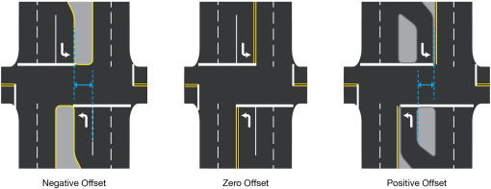
Offset Left-Turn Lanes
Notes:
These figures are from a signalized intersection (main street stop line), but it still applies at unsignalized intersections. If you cannot see the opposing traffic, you cannot judge the gaps.

Slide 37
Strategy B6 - Provide Right-Turn Lanes at Intersections
Many collisions at unsignalized intersections are related to right-turn maneuvers. A key strategy for minimizing such collisions is to provide exclusive right-turn lanes, particularly on high-volume and high-speed major-road approaches. Right-turn lanes remove slow vehicles that are decelerating to turn right from the through-traffic stream, thus reducing the potential for rear-end collisions.
Notes:
This is a good thing, as indicated for high-speed major roadways. If you are trying to do speed management, and in a more urbanized area, the friction created by right turns in with the through vehicles may be a good thing.

Slide 38
Questions?

Slide 39
Category C - Improve sight distance at unsignalized intersections

Slide 40
Description of Objective C:
Improve sight distance at unsignalized intersections—Some collisions at unsignalized intersections occur because of limited sight distance for drivers who are approaching the intersection or who are stopped on an intersection approach. Provision of clear sight triangles in each quadrant of an intersection can minimize the possibility of crashes related to sight obstructions.

Slide 41
Strategy C1 - Clear Sight Triangles on Approaches to Intersections
Adequate sight distance for drivers at stop- or yield-controlled approaches to intersections has long been recognized as among the most important factors contributing to overall safety at unsignalized intersections. Estimates of the safety effectiveness of providing full intersection sight distance (ISD) where it does not currently exist suggest that up to a 20-percent reduction in related crashes can be expected.

Slide 42
Strategy C4 - Eliminate Parking that Restricts Sight Distance
Adequate sight distance for drivers at stop-controlled approaches to intersections has long been recognized as among the most important factors contributing to overall intersection safety. Although geometrically an intersection might have adequate sight distance, parking within the sight triangle might restrict it and should, therefore, be taken into consideration. Estimates of the safety effectiveness of eliminating parking that restricts sight distance have not been yet developed.

Slide 43
Category D - Improve availability of gaps in traffic and assist drivers in judging gap sizes at unsignalized intersections

Slide 44
Description of Objective D:
Improve availability of gaps in traffic and assist drivers in judging gap sizes at unsignalized intersections—Some collisions at unsignalized intersections occur because drivers have difficulty judging gap sizes before deciding whether to initiate a roadway entry or a turning maneuver. Drivers stopped to wait for the oncoming traffic stream often choose to proceed when oncoming vehicles are close, thus increasing the probability for a collision.

Slide 45
Strategy D1 - Provide an Automated Real-Time System to Inform Drivers of the Suitability of Available Gaps for Making Turning and Crossing Maneuvers
Experimental

Slide 46
Strategy D3 - Retime Adjacent Signals to Create Gaps at Stop-Controlled Intersections
Drivers have difficulty making turning maneuvers at some unsignalized intersections because of the lack of sufficiently large gaps in through traffic. The lack of gaps can lead some impatient drivers to accept gaps shorter than needed for safe turning maneuvers, thus leading to turn-related crashes. Such crashes could be minimized if longer gaps could be made available. One method to provide longer gaps is to retime traffic signals at nearby intersections to create more gaps in traffic for turning maneuvers at the unsignalized intersection.

Slide 47
Questions?

Slide 48
Category E - Improve driver awareness of intersections as viewed from the intersection approach

Slide 49
Description of Objective E:
Improve driver awareness of intersections as viewed from the intersection approach— Some intersection-related collisions occur because one or more drivers approaching an intersection are unaware of the intersection until it is too late to avoid a collision. This is a particular problem for high-speed uncontrolled approaches. Improving signing and delineation and installing lighting can help warn drivers of the intersection. In some situations, where other measures have not been effective, rumble strips may be used to get the driver’s attention.

Slide 50
Strategy E1 - Improve Visibility of Intersections by Providing Enhanced Signing and Delineation
Many unsignalized intersections are not readily visible to approaching drivers, particularly drivers on major-road approaches that are not controlled by stop or yield signs. Thus, intersection crashes may occur because approaching drivers may be unaware of the presence of the intersection. The visibility of intersections and, thus, the ability of approaching drivers to perceive them can be enhanced by signing and delineation. Improvements may include advance guide signs, advance street name signs, warning signs, pavement markings, and post-mounted delineators.

Slide 51
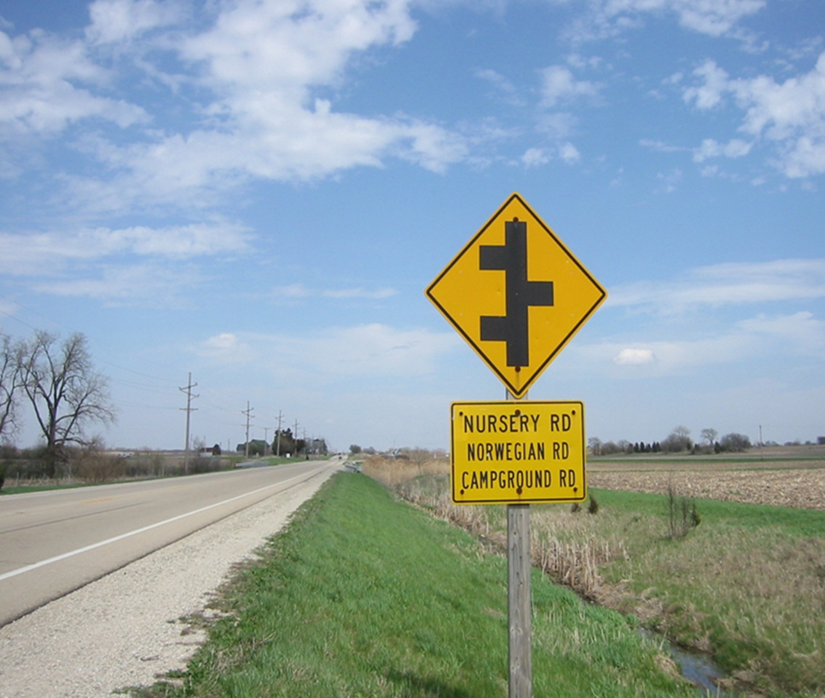
What is the name of this street?
Notes:
Correct answer: Campground Rd

Slide 52
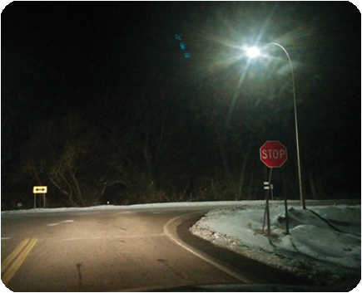
Strategy E2 - Improve Visibility of the Intersection by Providing Lighting
Providing lighting at the intersection itself, or both at the intersection and on its approaches, can make drivers aware of the presence of the intersection and reduce nighttime crashes.

Slide 53

Strategy E5 - Install Larger Regulatory and Warning Signs at Intersections
The visibility of intersections and, thus, the ability of approaching drivers to perceive them can be enhanced by installing larger regulatory and warning signs at intersections. Such improvements may include advance guide signs, warning signs, pavement markings, and post-mounted delineators.
Notes:
[click] or adding a retroreflective strip to the sign post has also shown to be very effective.

Slide 54
Strategy E6 - Call Attention to the Intersection by Installing Rumble Strips on Intersection Approaches
Rumble strips can be installed on intersection approaches to call attention to the presence of the intersection and to the traffic control in use at the intersection. Rumble strips are particularly appropriate on stop-controlled approaches to intersections where a pattern of crashes is present related to lack of driver recognition of the presence of the stop sign. Rumble strips should be used sparingly. Their effectiveness is dependent on being unusual.
Notes:
Typically high-speed rural locations.

Slide 55
Strategy E10 - Provide Improved Maintenance of Stop Signs
Maintenance of stop signs must be at a high standard to ensure that the effectiveness of the signs is retained. According to MUTCD criteria, stop signs must be kept in proper position, clean, and legible at all times (both by day and by night). Damaged signs should be replaced without undue delay. To ensure adequate maintenance, a suitable schedule for inspection, cleaning, and replacement of stop signs should be established.

Slide 56
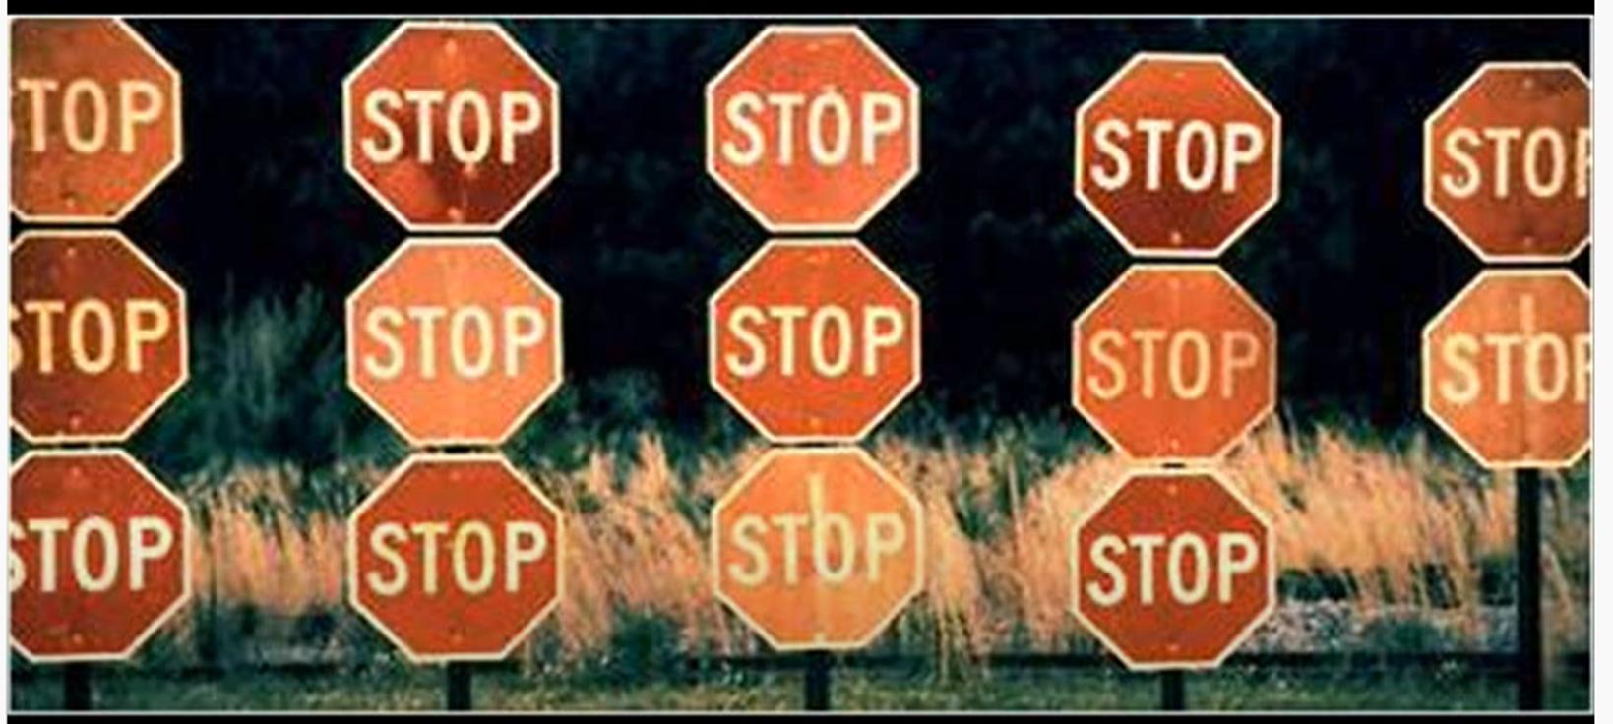
Strategy E10 - Provide Improved Maintenance of Stop Signs

Slide 57
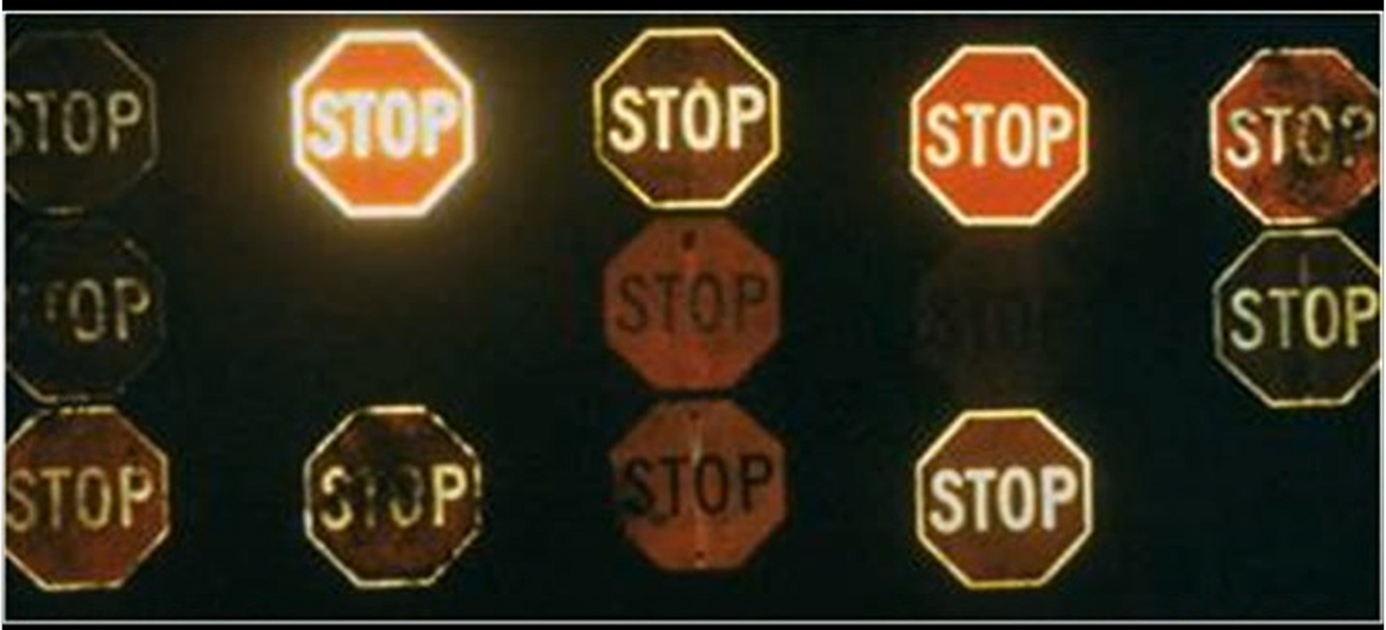
Strategy E10 - Provide Improved Maintenance of Stop Signs

Slide 58
Questions?

Slide 59
Category F - Choose appropriate intersection traffic control to minimize crash frequency and severity

Slide 60
Description of Objective F:
Choose appropriate intersection traffic control to minimize crash frequency and severity—The type of traffic control chosen for an intersection has a strong influence on the frequency and severity of crashes that occur at the intersection. The type of traffic control should be appropriate for the configuration of the intersection and the traffic volumes to be served. Unsignalized intersections generally have fewer crashes than comparable signalized intersections, so signalization should be avoided where practical. Alternatives to signalization that should be considered are two-way stop control (with or without flashing beacons), all-way stop control (with or without flashing beacons), and roundabouts.
Notes:
This is what ICE – Intersection Control Evaluation – is all about.

Slide 61
Strategy F2 - Provide All-Way Stop Control at Appropriate Intersections
All-way stop control can reduce right-angle and turning collisions at unsignalized intersections by providing more orderly movement at an intersection, reducing through and turning speeds, and minimizing the safety effect of any sight distance restrictions that may be present. However, all-way stop control is suitable only at intersections with moderate and relatively balanced volume levels on the intersection approaches.
Notes:
Under other conditions, the use of all-way stop control may create unnecessary delays and aggressive driver behavior (i.e., deliberate ignoring of the stop control).

Slide 62
Strategy F3 - Provide Roundabouts at Appropriate Locations
Roundabouts provide an important alternative to signalized and all-way stop-controlled intersections. Modern roundabouts differ from traditional traffic circles in that they operate in such a manner that traffic entering the roundabout must yield the right-of-way to traffic already in it. Roundabouts can serve moderate traffic volumes with less delay than signalized or all-way stop-controlled intersections because traffic can normally traverse the roundabout without stopping.

Slide 63
Category G - Improve driver compliance with traffic control devices and traffic laws at intersections

Slide 64
Description of Objective G:
Improve driver compliance with traffic control devices and traffic laws at intersections—Many crashes are caused by noncompliance with traffic control devices or traffic laws at intersections. The use of enforcement has been shown to be an effective measure in reducing traffic-law violations and, consequently, in improving safety at intersections.

Slide 65
Strategy G1 - Provide Targeted Enforcement to Reduce Stop Sign Violations
Enforcement options are a potential countermeasure to unsafe and illegal motorist behavior at intersections. Studies report the reduction of traffic law violation when enforcement is used. Traffic law enforcement agencies will often select locations for targeted enforcement when crash, citation, or other sources of information suggest that the site is unusually hazardous due to illegal driving practices.

Slide 66
Strategy G2 - Provide Targeted Public Information and Education on Safety Problems at Specific Intersections
Providing targeted public information and education on safety problems at specific intersections is a preventive measure that can help improve driver compliance with traffic control devices and traffic laws at intersections. Public information and education programs often add effectiveness to targeted enforcement programs, as well.

Slide 67
Questions?

Slide 68
Category H - Reduce operating speeds on specific intersection approaches

Slide 69
Description of Objective H:
Reduce operating speeds on specific intersection approaches—At certain high-speed intersection approaches, speed-reduction measures may provide an approaching driver with additional time to make safer and more efficient intersection-related decisions. The speed-reduction measure will get the driver’s attention and prepare the driver for making a stop or other appropriate action, thus potentially reducing right-angle and rear-end collisions.

Slide 70
Strategy H1 - Provide Targeted Speed Enforcement
Law enforcement is considered an important contributor for maintaining traffic safety. However, limited resources, such as staff and funds, constrain the efforts of police providing targeted speed enforcement. Studies have shown that speed warning and enforcement help reduce the mean speed and consequently the number of injury, fatal, and property-damage-only crashes in which unsafe speed is the primary collision factor.

Slide 71
Strategy H2 - Provide Traffic Calming on Intersection Approaches through a Combination of Geometric and Traffic Control Devices
The goals of traffic calming are typically to reduce vehicle speeds, traffic volume, or both. Volume control measures limit traffic by restricting vehicle access. They include full street closures, half closures, diagonal diverters, median barriers, and forced-turn islands. Speed control measures can be divided into three types: vertical, horizontal, and narrowing. Vertical speed controls include speed humps, which are parabolic, circular, or sinusoidal mounds placed across a roadway. Speed tables are basically flat-topped speed humps. Horizontal speed controls slow traffic by requiring vehicles to shift direction in order to maneuver around them.
Notes:
This is something that many agencies including FDOT are starting to pay more attention to: speed management.

Slide 72
Category I - Guide motorists more effectively through complex intersections

Slide 73
Description of Objective I:
Guide motorists more effectively through complex intersections—As drivers approach and traverse complex intersections, they may be required to perform unusual or unexpected maneuvers. Providing more-effective positive guidance through the intersection through signing and pavement markers will minimize the likelihood of a vehicle leaving its appropriate lane and encroaching upon an adjacent lane. The additional guidance will also minimize indecision by drivers, thus reducing the potential for conflicts.

Slide 74
Strategy I1 - Provide Turn Path Markings
At most intersections, pavement markings are provided on the intersection approaches, but the pavement markings end near the stop line. Rarely are pavement markings extended into or continued through intersections. At complex intersections, however, it may be beneficial to provide motorists with additional information to help with vehicle positioning through the intersections. In particular, it may be desirable to extend pavement markings through intersections that have offset approaches, are skewed, have multiple turn lanes, or are located at unsignalized ramp terminals. This approach is especially useful for delineating vehicle turning paths through an intersection.

Slide 75
Strategy I3 - Provide Lane Assignment Signing or Markings at Complex Intersections
Sometimes, as drivers approach a complex intersection, they have difficulty determining the appropriate lane from which to perform a certain maneuver. This can cause indecision among drivers and result in maneuvers being made from certain lanes that are unexpected. These maneuvers could potentially lead to crashes. Crash patterns that are characteristic of driver indecision related to lane assignment include rear-end and sideswipe crashes on intersection approaches and potentially angle crashes when a driver performs an unexpected maneuver from an inappropriate lane.

Slide 76
Questions?

Slide 77
Unsignalized Intersection Safety Strategies

Slide 80
Questions?

