Slide 1


District One Advanced Traffic Safety Academy
Presented by: Larry Hagen, P.E., PTOE, RSP
Session 1 – Florida’s SHSP Update

Slide 2
Advanced Traffic Safety Academy
Florida’s SHSP Update
Advanced Unsignalized Intersection Safety Treatments
Advanced Signalized Intersection Safety Treatments
NCHRP 500
Safe Systems Approach
Hot-Button Safety Review
Innovative Intersection Designs
Combining Safety Countermeasures
Human Factors in Highway Safety
Safety Evaluation Workshop
Safety Evaluation Workshop
Building a Safety Culture

Slide 3
Advanced Traffic Safety Academy
Florida’s SHSP Update
Advanced Unsignalized Intersection Safety Treatments
Advanced Signalized Intersection Safety Treatments
NCHRP 500
Safe Systems Approach
Hot-Button Safety Review
Innovative Intersection Designs
Combining Safety Countermeasures
Human Factors in Highway Safety
Safety Evaluation Workshop
Safety Evaluation Workshop
Building a Safety Culture

Slide 4
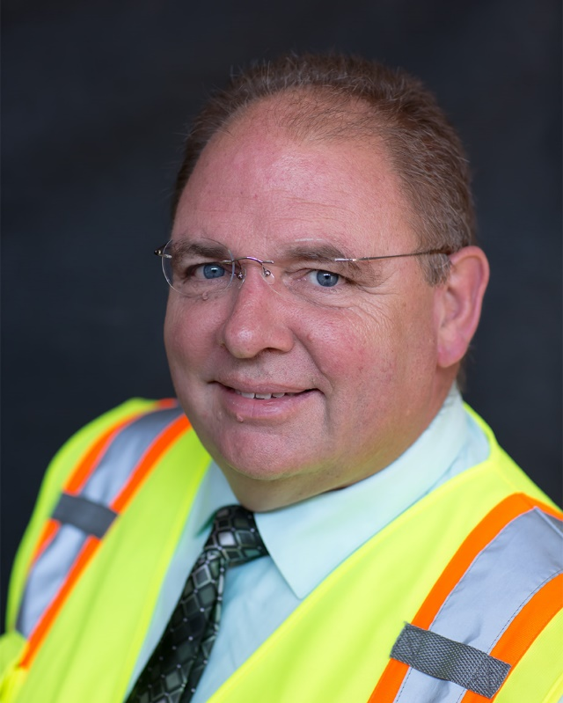
Larry Hagen, P.E., PTOE, RSP
Native Floridian
BSCE and ME Degrees from University of Florida
35+ years of Experience
  Public Sector (FDOT + County)
  Private Sector (Large – Medium – Small)
  Academia (Research & Teaching)
Worked in all FDOT Districts
FBPE-approved Provider of PDHs

Slide 5

Self-Introductions
Your name
What office you work in
How long have you been with FDOT
Your role in making our roadways safer
What you hope to learn in the Safety Academy

Slide 6
Notes:
The update to the SHSP was finalized in March of 2021

Slide 7
Notes:
It opens with a letter from Secretary Thibault. A few quick highlights from his letter:

Slide 8
FDOT Secretary Kevin Thibault
As we continue working toward “Vision Zero,” the Florida Strategic Highway Safety Plan serves as a framework of plans and activities that will improve safety and efficiency on our roadways with an ultimate goal of zero fatalities and serious injuries.

Slide 9
FDOT Secretary Kevin Thibault
To push safety forward, we must collectively employ the 4Es of traffic safety:
Engineering
Education
Enforcement
Emergency Response

Slide 10
FDOT Secretary Kevin Thibault
…as well as the 4Is addressing:
Information Intelligence
Innovation
Insight into Communities
Investment and Policies

Slide 12
How are we currently doing?

Slide 13
Notes:
Pg 3

Slide 14
Several Challenging Trends For Vision Zero:
Strong Growth in Florida Population
Notes:
See pg 4 of SHSP

Slide 15
Several Challenging Trends For Vision Zero:
Strong Growth in Freight Traffic

Slide 16
Several Challenging Trends For Vision Zero:
Strong Growth in Florida Visitors

Slide 17
Several Challenging Trends For Vision Zero:
Strong Growth in Vehicle Miles Traveled

Slide 18
Notes:
Yes, the number of people working from home completely changed in 2020, but that was an outlier.

Slide 19
The Planning Process
Aligns with other state plans
Aligns with other state agencies
Notes:
See pg 6 of SHSP

Slide 20
The Planning Process
Notes:
See pg 7 of SHSP

Slide 21
Measuring Our Progress
Notes:
See page 8

Slide 22
Measuring Our Progress
Notes:
Pg 9

Slide 23
Key Strategies – the 4 E’s

Slide 24
Key Strategies – the 4 E’s

Slide 25
Key Strategies – the 4 E’s

Slide 26
Key Strategies – the 4 E’s

Slide 27
Key Strategies – the 4 I’s

Slide 28
Key Strategies – the 4 I’s

Slide 29
Key Strategies – the 4 I’s

Slide 30
Key Strategies – the 4 I’s

Slide 31
Notes:
Florida’s Emphasis Areas - Pg 15

Slide 32
Florida’s Emphasis Areas

Slide 33
Why Aging Road Users and Teen Drivers?
Crashes per VMT
Age

Slide 34
Florida’s Emphasis Areas

Slide 35
Lane Departures
Notes:
Pg 18

Slide 36
Lane Departures
Notes:
Pg 19

Slide 37
Intersections
Notes:
Pg 20

Slide 38
Intersections
Notes:
Pg 21

Slide 39
Pedestrians & Bicycles
Notes:
Pg 22

Slide 40
Pedestrians & Bicycles
Notes:
Pg 23

Slide 41
Aging Road Users
Notes:
Pg 24

Slide 42
Aging Road Users
Notes:
Pg 25

Slide 43
Motorcycles & Motor Scooters
Notes:
Pg 26

Slide 44
Motorcycles & Motor Scooters
Notes:
Pg 27

Slide 45
Commercial Motor Vehicles
Notes:
Pg 28

Slide 46
Commercial Motor Vehicles
Notes:
Pg 29

Slide 47
Teen Drivers
Notes:
Pg 30

Slide 48
Teen Drivers
Notes:
Pg 31

Slide 49
Impaired Driving
Notes:
Pg 32

Slide 50
Impaired Driving
Notes:
Pg 33

Slide 51
Occupant Protection
Notes:
Pg 34

Slide 52
Occupant Protection
Notes:
Pg 35

Slide 53
Speeding & Aggressive Driving
Notes:
Pg 36

Slide 54
Speeding & Aggressive Driving
Notes:
Pg 37

Slide 55
Distracted Driving
Notes:
Pg 38

Slide 56
Distracted Driving
Notes:
Pg 39

Slide 57
Notes:
Pg 40

Slide 58
Notes:
Pg 41

Slide 59
Evolving Emphasis Areas
Notes:
Pg 42-43

Slide 60
Safe Systems Approach
Notes:
Pg 9

Slide 61
Safe Systems Approach
Notes:
Pg 35

Slide 62
Safe Systems Approach

Slide 63
Safe Systems Approach

Slide 64
Safe Systems Approach

Slide 65

Questions?

